Slide 1
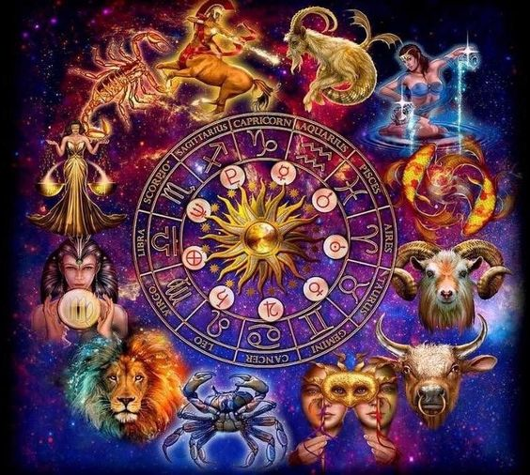


2019 – MARCH - A Look Ahead

Slide 2
What is the
Monthly New Moon Energy for March 2019?
And What Does It Mean?

Slide 3

Sun in Pisces
Feb 18 – March 20, 2019
Your identity, purpose, will and self-expression is gauged through how you are at Peace at this time.
A Good Time For: Trusting your intuition. Creating your vision.
Adaptability, a chameleon, able to take on many roles as situations arise.
A time to be easily ‘tuned in’ to the spiritual world or emotional currents.
Veils thin to unseen worlds of the heart and imagination.
Artistic expressions, music, poetry, dance, creativity flourish at this time.
Compassionate or self-sacrificing endeavors for charity or good will.
Establishing a daily routine to keep yourself grounded and on task.
Possible Difficulties:
You may tend martyr yourself for others, or be easily taken advantage of if you do not set and keep strong boundaries in place.
You may tend to take on other people’s problems and loose your sense of self or separateness in situations.
May be vague and not clear in communications.
May be more prone to escapism through addictions or personal dramas.

Slide 4


New Moon in Pisces
March 6, 2019 – 15° Pisces - (USA 10th House)
Emergence.
New experiences will be initiated
in your life, encouraging you to commit yourself to a ‘dream’ or ‘ideal’ and to work toward its realization. You may spontaneously or instinctively
feel a ‘need’ to plunge into new opportunities that
present themselves to you.
Fulfillment
Security is found through emotional intimacy
In a nurturing, feeling and/or inspirational way
Adapting to emotional and soul learning opportunities
Imaginative, romantic, artistic, or spiritual ideals
Compassion and healing
Challenges
Tendency to sacrifice, martyr or ‘loose’ self autonomy for others
Desire to escape or retreat from reality
Following secretive self-destructive, cloudy, or unrealistic, beliefs.
Procrastination.
A new doorway opens, and/or an impact presents itself leading to a new beginning of something yet to born:
Offers fulfillment to ‘unconscious emotions, feelings and needs for security’ through unity - by dissolving barriers.
Unselfish surrendering to a visionary ideal.
May address past habit patterns: ‘utopian’ vs ‘delusional’
May involve endings, completion of unfinished business or dreams and moving on.

Slide 5
New Moon in Pisces March 6th, 2019 – 15° Pisces
New experiences initiated encouraging you to be flexible with your emotional habit patterns for need of ‘security’ involving public image, social standing in community, career, or reputation.
Sensitivity increased; yearning to experience bliss of ’hearts desire’
Stimulation of fantasy - of utmost happiness or delusions of it.
Abundance of growth and optimism of committed partnerships. Possible misinterpretation of professional promises by both parties.
Problems with communications involving unrealistic ideas of team union; lack of clarity, excessive goals of partner, group needs to ‘heal’.
Isolated growth behind the scenes involving internet, charity, ‘love’ or money for promotion, expertise, foreign or intellectual desires.
(team, children or loved ones may not be available or able to perform)
Letting go of possessions, valued memories or what is loved for progressive expansion of awareness, new beliefs, reformed stability.
Fears or rage of unexpected desires of group need to be discussed.
MONEY, VALUES, or RESOURCES received from others a problem. Limitations or practical restrictions from powerful ‘monied’ authorities of the past, require YOU to make personal sacrifices. Using YOUR assets – land, family or public resources for ‘realization of the dream.’

Slide 6
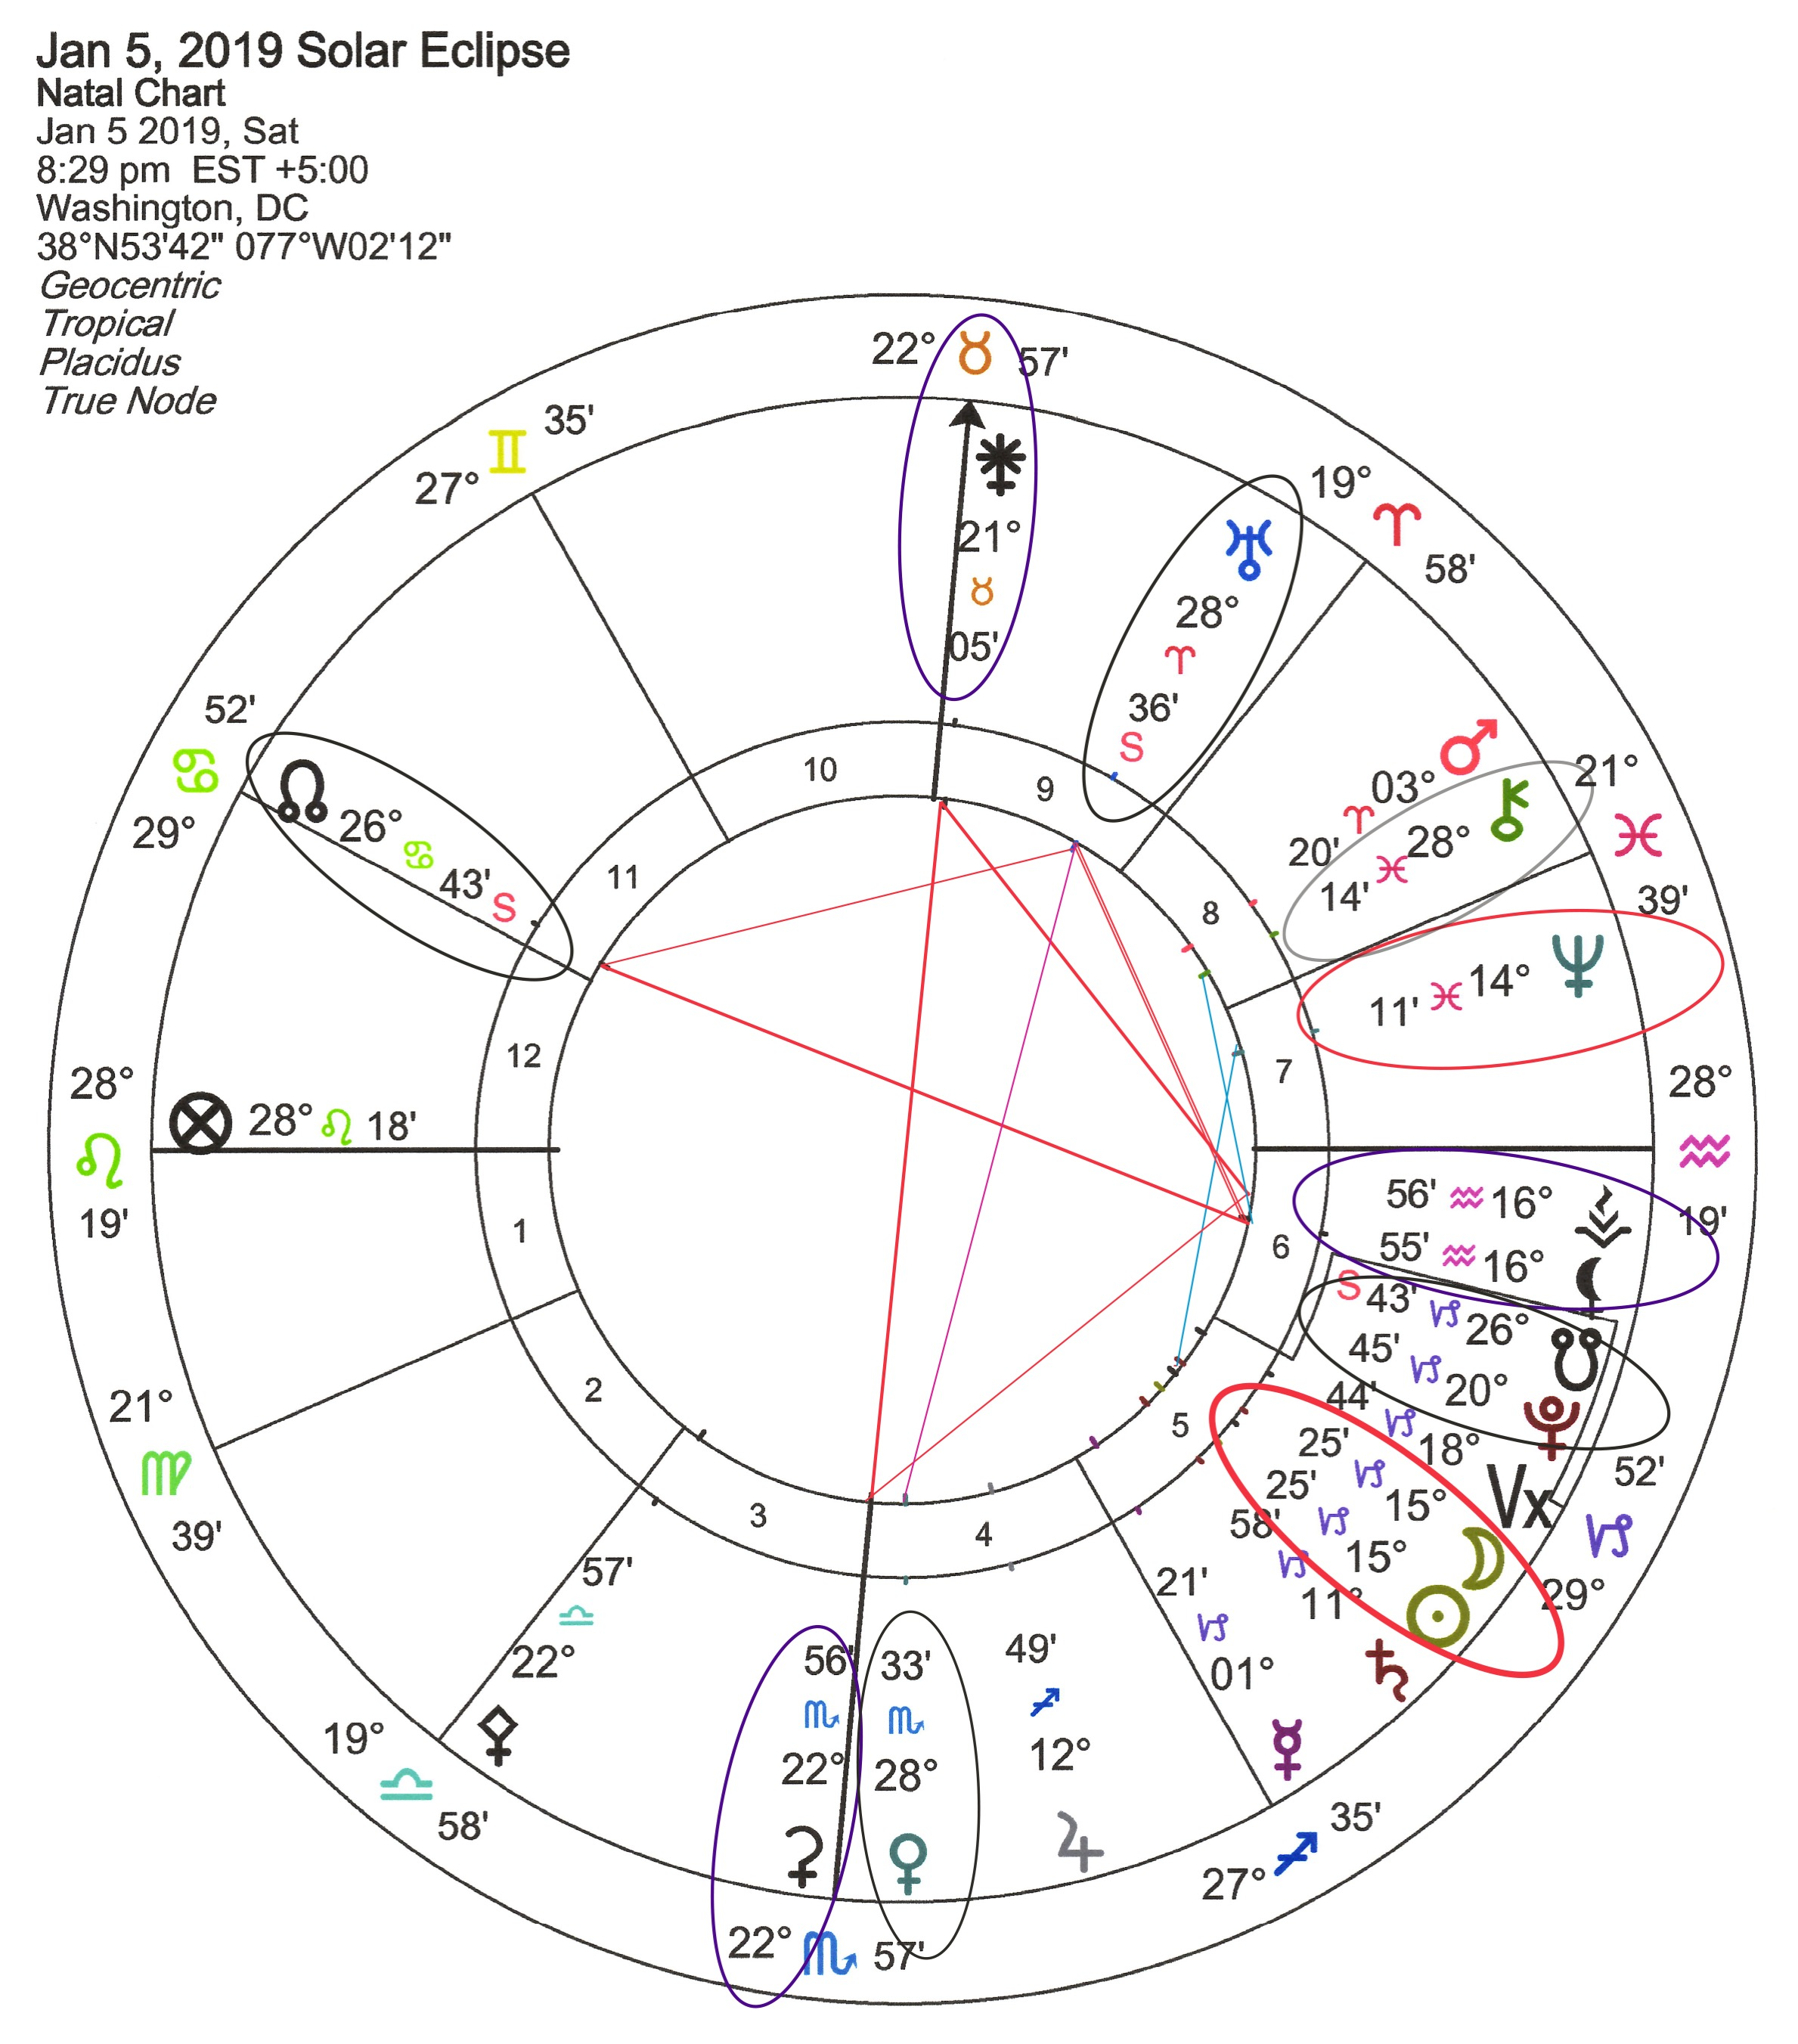
January 5, 2019 Solar Eclipse
Involvement with Unusual Groups
Saros Series 2 South
Started April 17, 991 (South Pole)
Ends May 19, 2235 (North Pole)
Chart ruled by Leo: (15° Capricorn - 5th H – USA)
A test in creative self-expression. Leadership via commitment of self- love, honoring core beliefs, soul-purpose, and daily needs.
Opportunity to build reputation. professional, parental, steward.
Public stewardship/expression via groups - with children, loved ones, heartfelt creative enjoyment - via intuition, reflection.
Letting go of conservative beliefs that have control of you.
Personal empowerment - wisdom from the past, involving advice, education, personal journey, caretaking ‘soul of operation’.
Transformational mentors (wise women) -.
- How to deal with letting go of ‘traditional roles of power + control’,
Transcend limits, experience loss, grief, forgiveness = heal the
family, core foundation, the land, and the world.
Public alignment with powerful stable partner(s).
Rearranging operations for partners security. (family, loved ones)
Credit, merging joint resources - future goals, work, contracts.
Personal reorientation of daily routine: A blending of rage, fear, abandonment and bliss of freedom – mixed all together.
Repetition: Similar in expression: Dec. 25, 2000 / Jan. 9, 2001.

Slide 7

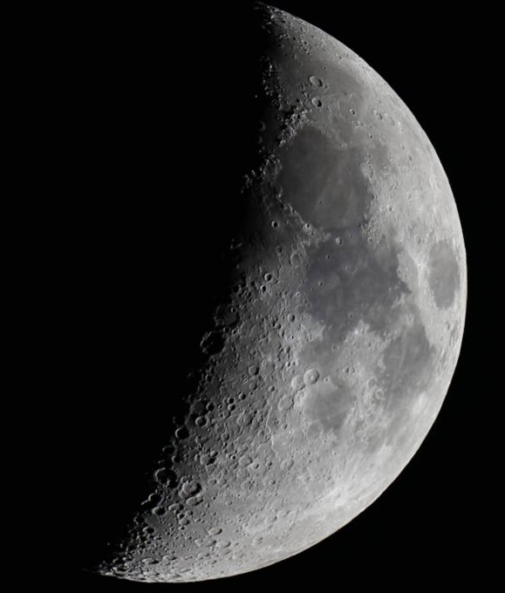
First Quarter Moon - Gemini
March 14, 2019 – 23° Gemini (6:27 am) – sq SU 23° Pisces
Action.
To a situation that started on
March 6th, 2019 – New Moon- (25° Pisces)
Empowerment – to work through a challenge or crisis by adapting to social and intellectual learning. Communicating and learning from others as you resolve the blocks in your way.
(US 1st House)
The ‘stress’ of growth begins, by speaking, planning, or organizing group transactions with rational logic - to develop a stronger sense of self to negotiate ‘the partner’s dream’.
Cultivating a united network – from an eclectic group of people, unexpectedly thrown together; to ‘inspire or surrender to’ a common goal – requiring hard work.
Overcome confusion with groups, business or reputation. Flexibility required with ‘self’ agenda; Turn excessive idealism into ‘details/facts’; Educate ‘career aspirations’ with authority.
Fulfillment
Security is found through
the world of ideas.
May be dealing with: daily operations or commerce involving prosperous relationships with foreign partner(s) – the union of your vision vs your partner’s vision
Challenging Behaviors:
Overly abstract
Non-committal
Gossiping or superficial
Inconsistent or scattered information
Indecisive
Nervous
Impatient
Notes:
Making collective changes to your body or immediate environment: sharing social media everyday to inspire public perceptions

Slide 8


Full Moon in Libra
March 20, 2019 – 0° Libra (9:43 pm) – oppose SU 0° Aries – Vernal Equinox
Illumination.
To a situation that started on
March 6th, 2019 – New Moon- (25° Pisces)
Ideal fulfillment or opposition (involving social or intellectual relationships), by offering committed partnership toward a ‘mission with goals of self-expression’, vs cooperation with ‘goals of loyalty to the group’ based on the direction current life structures are headed in.
Fulfillment
Initiating diplomatic relations with loved ones, children vs team and colleagues, due to unpredictable finances, travel, education, goals.
Both - yielding to the possibility of ‘charitable’ growth, letting go of indulgences, inconsistent desires, exciting expansion of expertise.
Opposition
Indecision from others in giving commitment to you.
Dependency, unable to trust self or others to act alone - to hold up to an agreement of equality or performance
Superficial agreements
(US 5th House – oppose 11th House – both intercepted )
As the moon increases in light,
an understanding culminates at the Full Moon.
Full conscious awareness comes to light.
ie: the enlightenment of a ‘previous unconscious’ situation (possibly through an opposition).

Slide 9
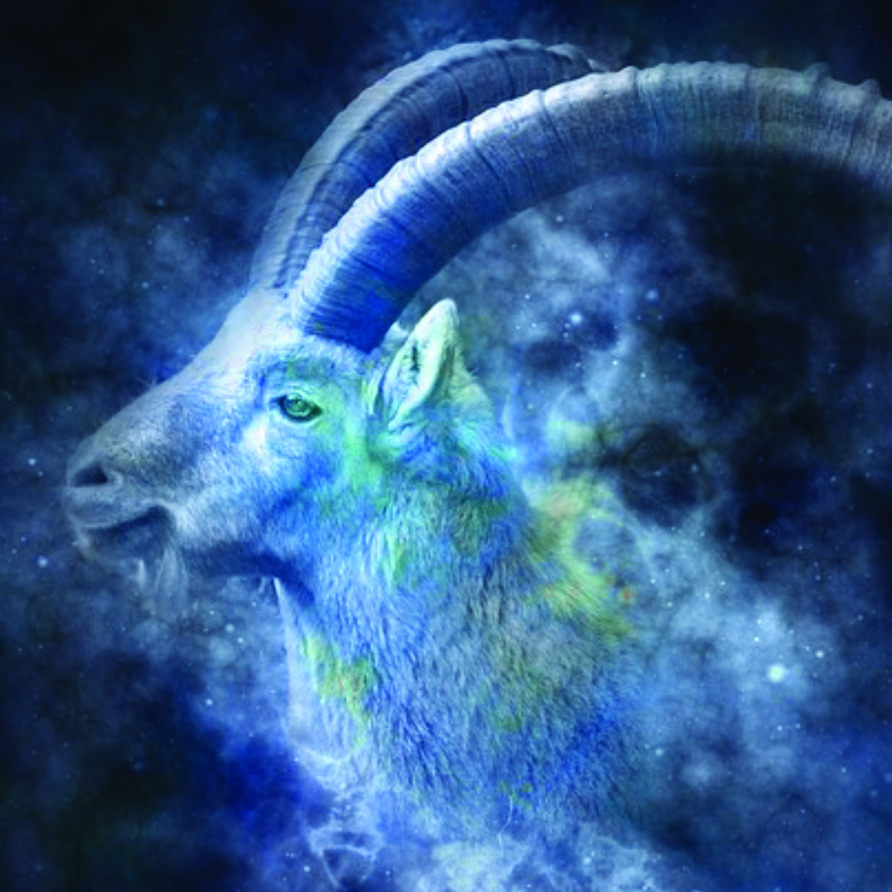
Last Quarter Moon - Capricorn
March 28, 2019 – 7° Capricorn (0:10 am) – square SU 7° Aries
Reorientation.
To a situation that started on
March 6th, 2019 – New Moon- (25° Pisces)
Crisis in consciousness, turning away from ‘initiating material actions for ‘partner’ at the expense of YOUR needs. No longer put up with ‘limitations of partners’ responsibility’ in the relationship: frugal resources and time management, requiring financial or ‘exclusivity’ restrictions on you. Unpredictable goals affecting group loyalty or inability to perform = limitations put on group’s hopes/social dreams.
(USA - 7^{h} House)
A need to resolve or release blocks in the relationship,
leads to development of maturity in personal character
upholding contracts or agreements in one-to one relations:
Cultivating reformed resources between ‘partner’ and ‘group’ to equally ‘respect and match’ YOUR contributed efforts to build joint ‘dream’ of union. Take progressive action, supporting YOUR values + group goals, speculations.
Cooperate and create structured balance of accountability or let go of ‘loyalty of team performance’ to partner.
Fulfillment
Security is found through realistic form and structure.
Negotiate realistic terms.
Or let go of restrictive controls put upon YOU by intimate union with partner’s resources.
Challenging Behaviors:
Obsessed with order
Over-ambitious or
Over-cautious.
Controlling conservatism.
Manipulation.

Slide 10
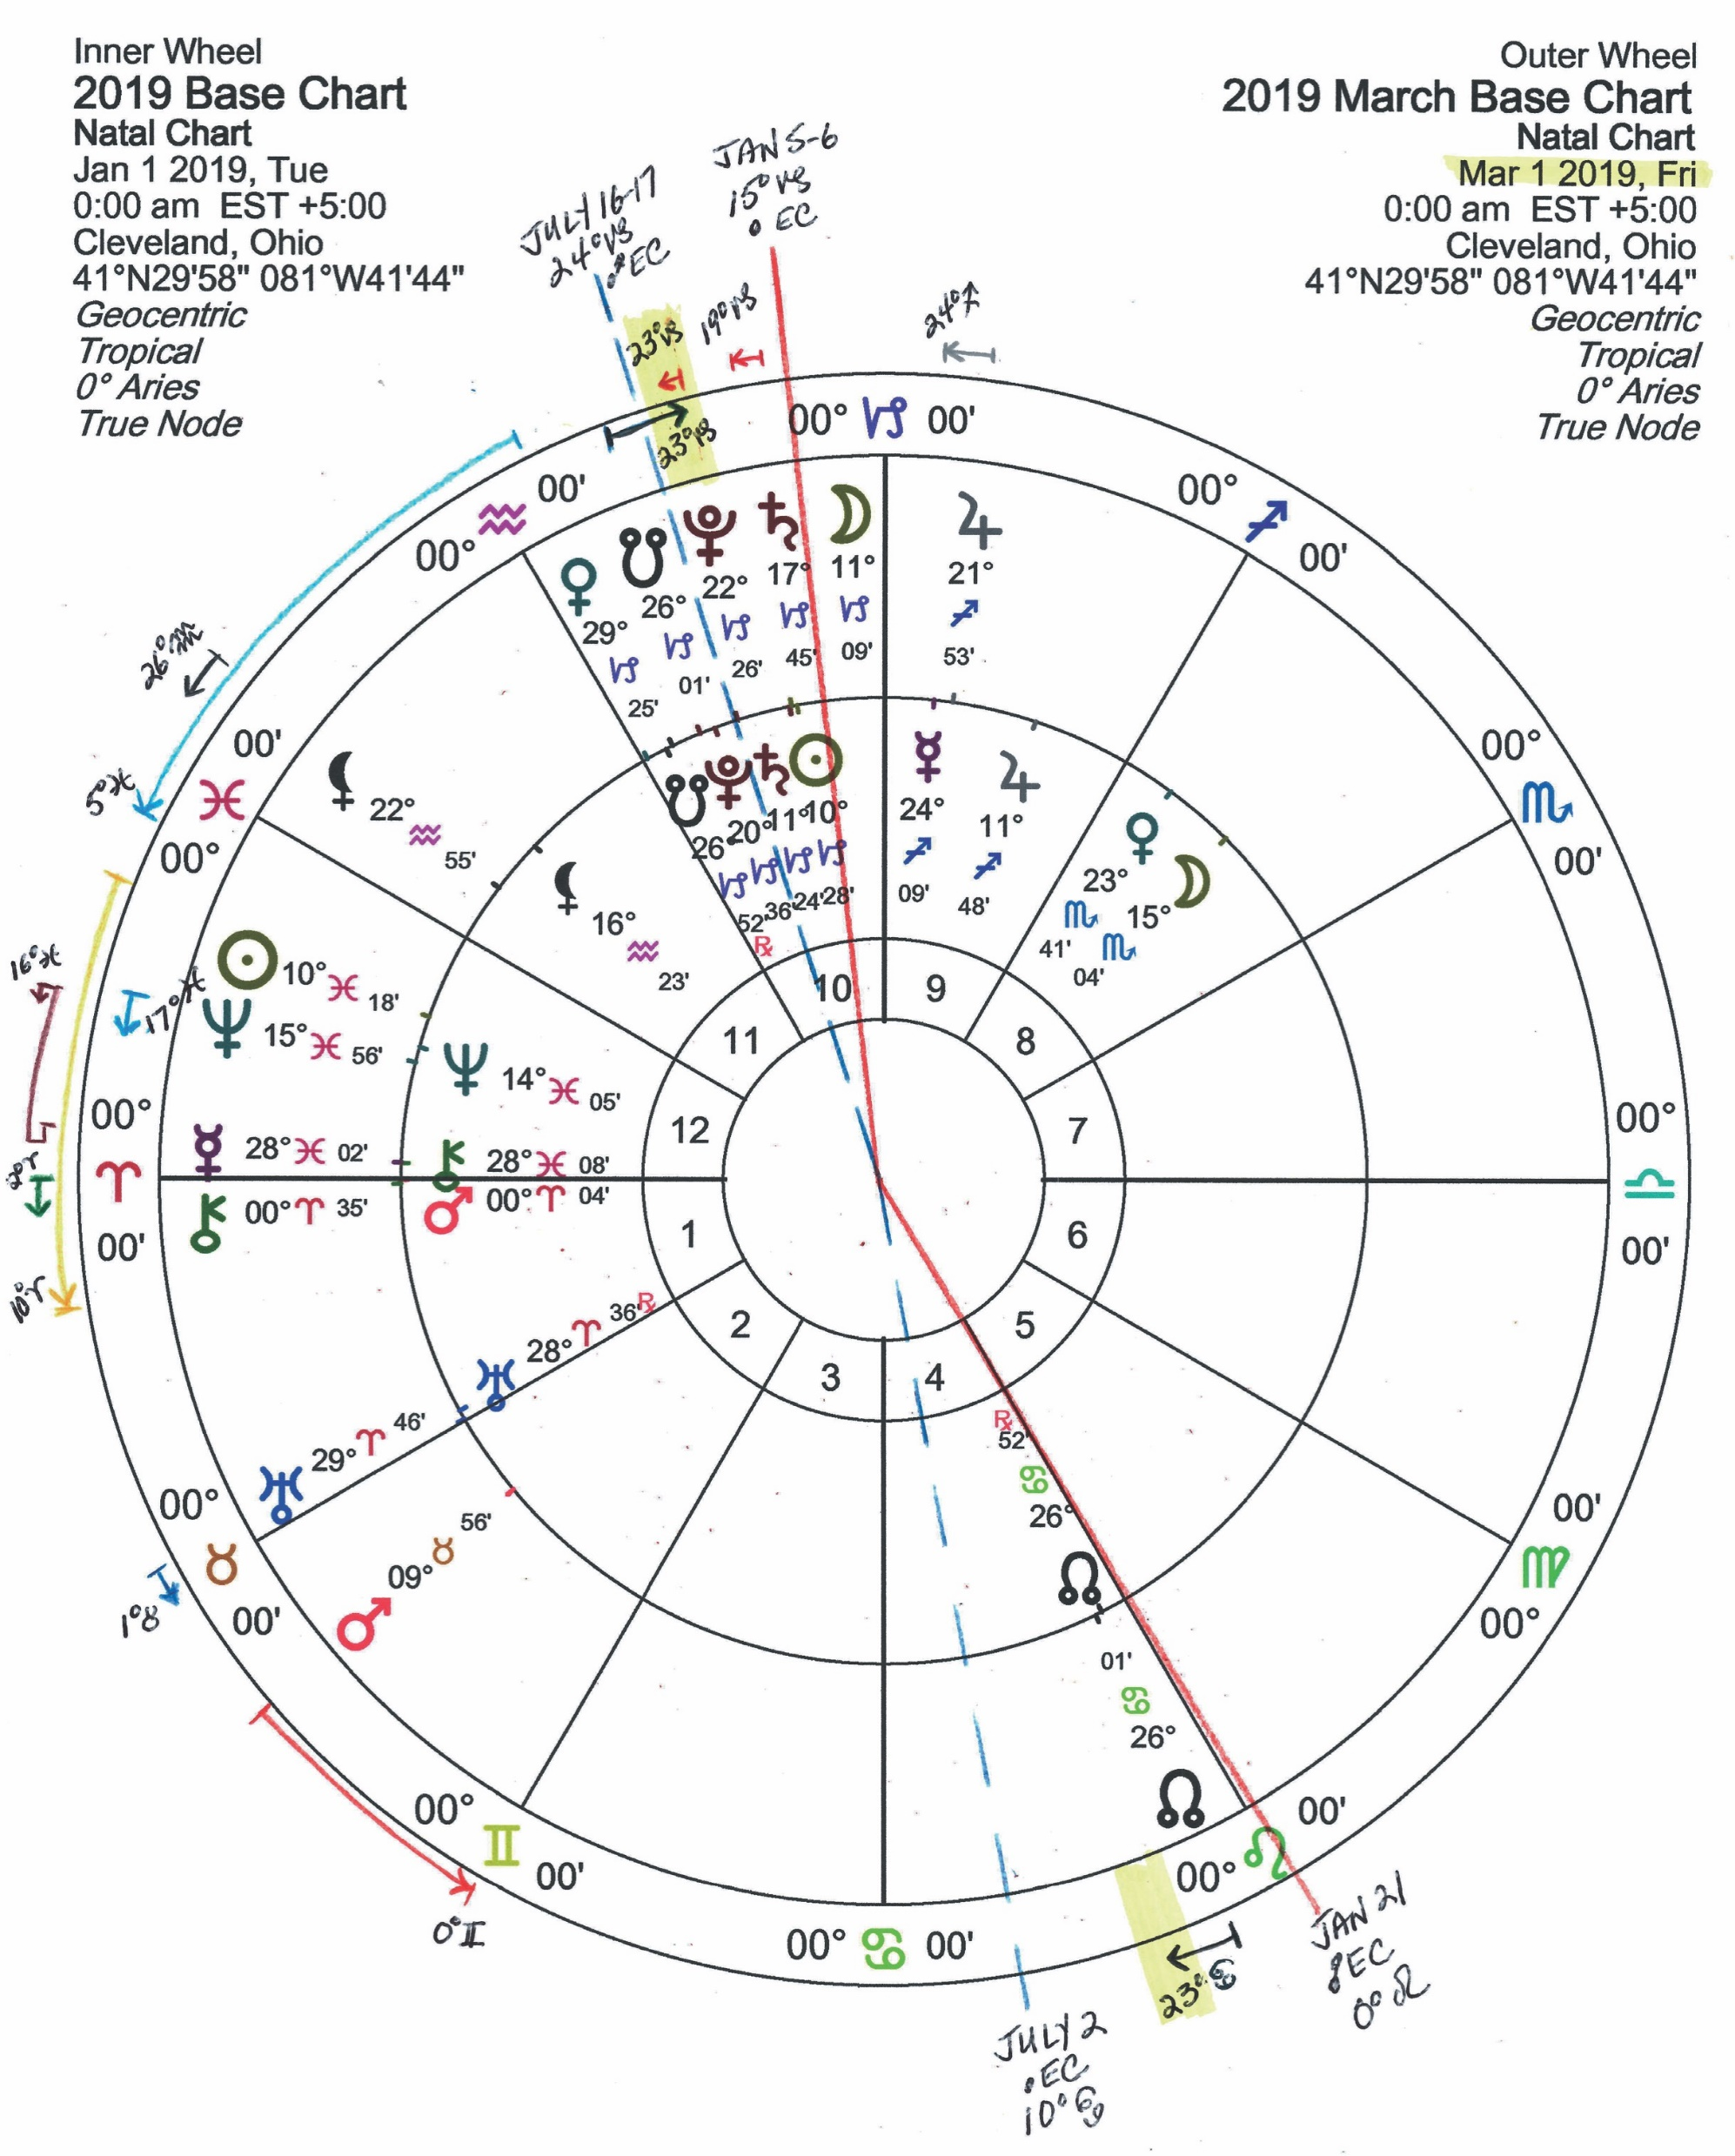
March Key Dates 2019
Mar 1: VE 29° Cap square UR 29° Ari | Lilith 22° Aqu semi-sex PL 22° Cap
Mar 1: VE enters 0° Aquarius | NE 15° Pis sextile SE 15° Cap (USA 5th H)
Mar 1-2: MA 10° Tau sextile SE 10° Can (USA 9th H)
Mar 1-8: CH 0° Ari trine LE 0:52 Leo (USA 10th/MC MO oppose 4th/IC SU)
Mar 2-11: JU 22° Sag semi-sextile PL 22° Cap
Mar 5-28: Mercury Rx 29° Pieces (1:19 pm)
Mar 6: New Moon 15° Pisces (11:04 am) – USA 10th House
Mar 6: SU 16° Pis conjunct NE 16° Pis
Mar 6-8: CH 0° Ari semi-sex UR 0° Tau
Mar 6-26: UR enters 0° Tau square LE 0:52 Leo (USA 10th/MC MO opp 4th/IC SU)
Mar 9: MA 15° Tau trine SE 15° Cap (USA 5th H) | SU 18° Pis sextile SA 18° Cap
Mar 10-11: MA 16° Tau sextile NE 16° Pis
Mar 12-24: NN 24° Can quincunx Lilith 24° Aqu
Mar 13: SU 22° Pis sextile PL 22° Cap | SU 23° Pis square JU 23° Sag
Mar 14: 1st Quarter Moon 23° Gem (6:27 am) – sq SU 23° Pis
Mar 14: MA 18° Tau trine SA 18° Cap | SU 23° Pis conj ME 23° Pis Rx
Mar 15: ME 23° Pis Rx square JU 23° Sag
March 16: CH Shadow Begins - 1:26° Aries | ME 22° Pis Rx sextile PL 22° Cap
Mar 16-17: MA 20° Tau sextile SE 20° Can-2nd/8th H USA) – early activation
Mar 17: ME 21° Pis Rx sextile MA 21° Tau
Mar 19-20: MA 22° Tau trine PL 22° Cap | ME 19° Pis Rx sextile SA 19° Cap |
Mar 20: Full Moon 0° Libra (9:43 pm) – opp SU 0° Aries - vernal equinox
Mar 21: VE 23° Aqu square MA 23° Tau | VE 23° Aqu sextile JU 23° Sag
Mar 22-23: MA 24° Tau trine LE 24° Cap (USA 2nd/8th H)- early activation
Mar 22-23: MA 24° Tau sextile NN 24° Cancer | square Lilith 25° Aqu |
Mar 24: ME 16° Pis Rx conj NE 16° Pis
Mar 25-26: JU 23° Sag quincunx NN 23° Cancer
Mar 26: VE enters Pisces 0°
Mar 27: VE sextile UR
Mar 27-Apr 25: JU 24° Sag semi-sextile LE 24° Cap (USA 2nd/8th H)- early activation
Mar 28: 3rd Quarter Moon 7° Cap (0:10 am) – sq SU 7° Aries
Mar 29: ME Direct 16° Pisces (9:59 am)
Mar 30-31: PL 23° Cap oppose NN 23° Cancer
Mar 31: MA enters 0° Gem sextile LE 0:52 Leo (USA 10th/MC oppose 4th/IC SU)

Slide 11
Thank You!

