Slide 1
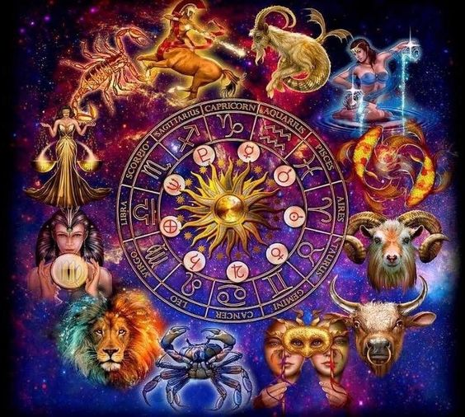
2019 – MARCH - A Look Ahead

Slide 2
What is the Planetary Landscape for March 2019?
And What Does It Mean?

Slide 3
Venus in Aquarius
March 1 -26, 2019
Seeking thoughts, ideas and mental interactions with others…
to fulfill the need to attract love and value.
A Good Time For: Being A Free Spirit.
Cheerful, popularity, extending friendship to an eclectic mix of people.
Progressive, striking or shocking style of dress and beauty. From ultra-chic, to edgy camp or piercings and tattoos.
Independent outlooks to relationships = surprising choices in love.
Intimate encounters may be at odds with your nature at this time. A tendency to be aloof and need a lot of space.
Humane, tolerant, fair practices and non-judgmental behaviors, may attract misfits or unorthodox people into your life at this time.
Values for justice, social welfare, and championing the underdog.
Possible Difficulties:
Contradictory, surprising, off-beat, and unusual spontaneous desires.

Slide 4
Mercury in Pisces
Feb 10th – March 5 – 29 Rx (29°–16° Pis) - April 16th 2019 - 65 days/2 mo in Pis – (normally 18 days)
Mercury is in detriment and fall in Pisces, having low potency and greatly OBSTRUCTED in it’s manifestation of acquiring knowledge, formulating concepts, and communicating them to others within ‘stable reality’.
However it can be great for expressing Intuition and Imagination when applied towards poetry and the arts.
A Good Time For: Trusting your intuition. Creating your vision.
Adaptable, like a chameleon, able to take on many roles.
A time to be easily ‘tuned in’ to the spiritual world or emotional currents.
Veils are thin to unseen worlds of the heart and imagination.
Artistic expressions, music, poetry, dance, creativity flourish at this time.
Compassionate or self-sacrificing endeavors for charity or good will.
Establishing a daily routine to keep yourself grounded and on task.
Possible Difficulties:
You may tend martyr yourself for others, and be easily taken advantage of if you do not set and keep strong boundaries in place.
You may tend to take on other people’s problems and loose your sense of self or separateness in situations.
May be vague and not clear in communications.
May be more prone to escapism through addictions or personal dramas.

Slide 5
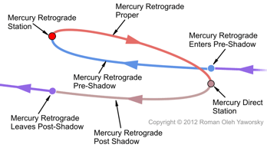
Mercury Retrograde Cycle
Feb 19 (full moon) – April 16, 2019 (16°-29° Pisces)
Rx
Mercury Pre-Shadow Events:
Feb 19 (16° Pisces) – March 5, 2019 (29° Pisces)
Mercury Retrograde – Research/Define:
March 5 (29° Pisces) – March 29, 2019 – (16° Pisces)
Mercury Post-Shadow Conclusion:
March 29 (16° Pisces) – April 16, 2019 (29° Pisces)

Slide 6
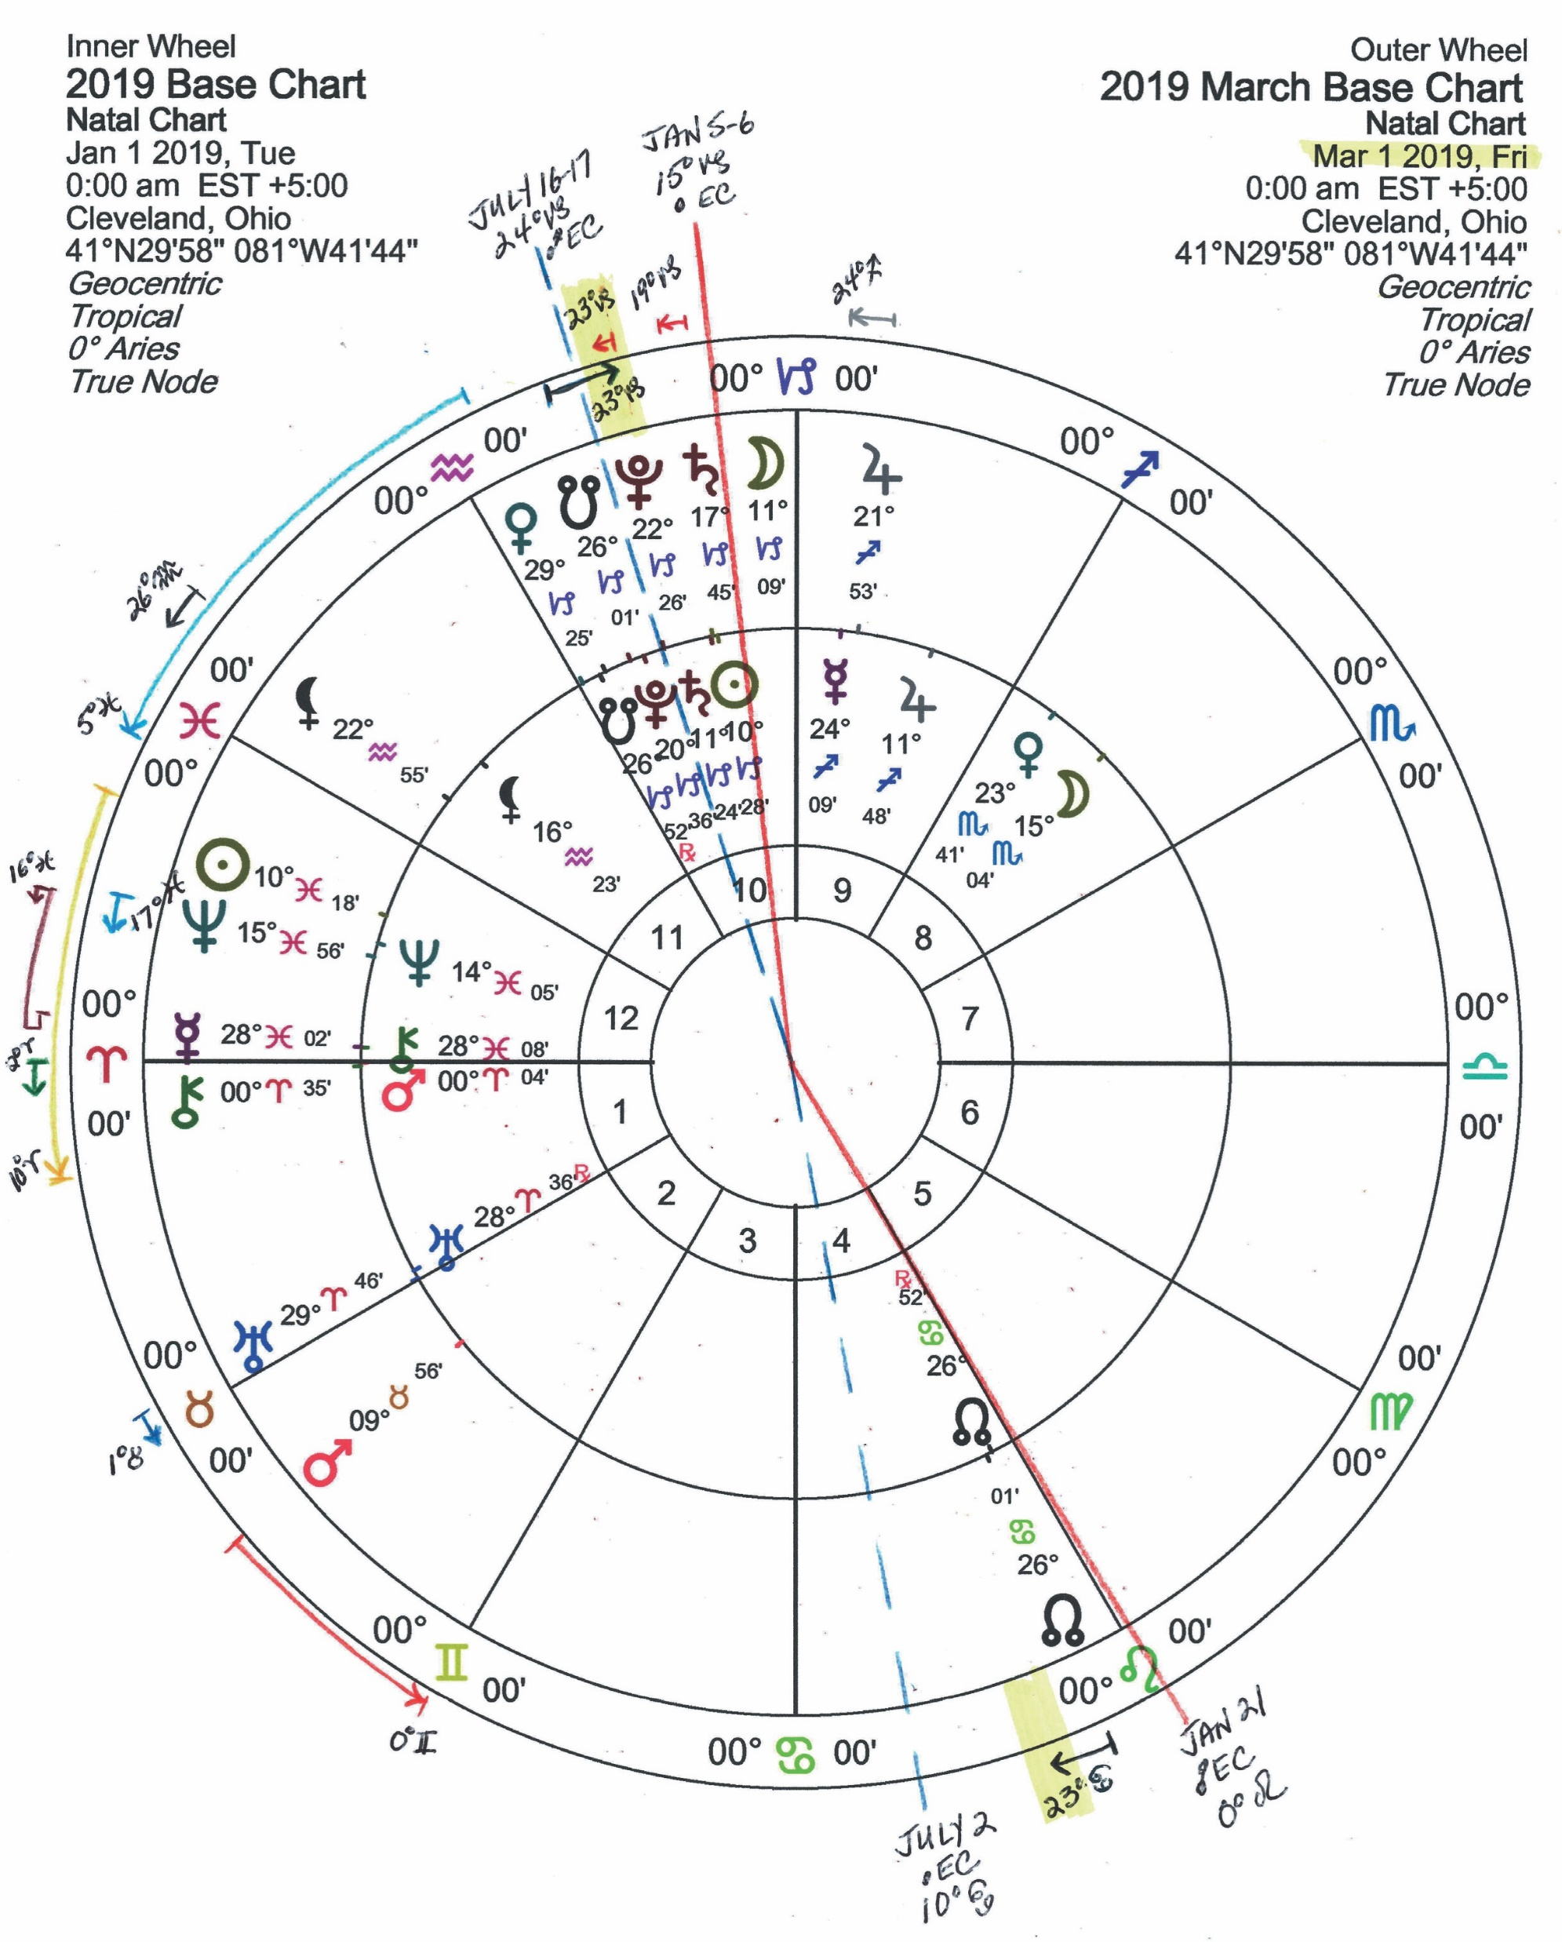
Mercury Retrograde
March 5 – 29 Rx (29°–16° Pis)
How Does The Retrograde Affect You?
A time to process confusion and unclear thinking!
- low confidence for you are in ‘unfamiliar waters’
A time to stop and smell the roses – for you are “on the threshold” of loosing, ending or releasing something…
• Support may come in from established or powerful authorities from the past. • Offers of potential increases of something YOU value: ie money, love, fertility, security, comforts, the good life.
A time to isolate, research, think, write and express hidden ideas & feelings – - Let your intuition, imagination and artistry flow. - Get in touch with your ‘inner psyche’, the mysteries, occult or spiritual philosophy.
Are you listening to your ‘inner’ self. Are your goals in alignment with your soul. Are you at peace with the direction you are headed?
It’s time to develop inner-awareness of a situation, that you may come to a decision - with clarity and confidence.
Rx

Slide 7
Mercury Retrograde
March 5 – 29 Rx (29°–16° Pisces)
You also need to determine if the ASPIRATIONS FOR EXPANSION + GROWTH
you’re involved in is in-line with YOUR INTERNAL PSYCHE,
ideals, dreams or ‘at peace’ with your soul. Is it commerce-based, logical judgement, or faith-based?
Legal, political, promotional or adventure-based?
OR based on past traditions that no longer serve you?
It’s also a time to investigate options, research possibilities that are foreign to you.
Get opinions or help from experts or advisors, read, travel, listen and learn.
Then together – internally and externally ’prepared’, cross the threshold and take action on the future agenda now better in-line with who you are.

Slide 8
Mercury Retrograde
March 5 – 29 Rx (29°–16° Pisces)
Communication and mental clarity can be expressed at the extreme ranges.
Routine communication may be ‘delayed’ and/or easily ‘misunderstood’ by others
Mercury Retrograde Periods Bring in:
Unique expression. Mental processing can be ‘introverted’ or become ‘overly extroverted’
Thought, Communication, and Association speed is ‘stunted’, ‘slow’, ‘backward’ or ‘overly promised’ in logical planning, processing and understanding.
May experience minor health extremes with breathing, anxiety, coordination, memory, digestion, throat, vision or hearing. (arteries, circulation, blood ,brain, cateracts, the back, glands, energy, eyes, or heart)
Printed Publications may have errors in final assessment. Also Public Announcements, Calculations, Schematics, Medical Diagnosis, Legal Decisions, or Travel Plans.
Problems with Electronics, Computers, Networking, Internet Connections, Mechanical Devices, Appliances are expected.
Mercury Retrograde Can Bring Back:
Money owed to you.
Unfinished projects from the previous Mercury Rx. Agreements, Contracts, Buyers/Sellers or Business Commerce from the past.
Past Advisors, Agents, Attorneys, Auditors, Class mates, Teachers, or Physicians into your life.
Reconnection with Siblings, Relatives, Neighbors.
It IS a good time:
To complete unfinished projects already started.
To research and develop a thorough understanding and focus on primary issues - not multiple.
To ‘internalize’ and review your own thoughts/goals.
To spiritually re-examine life. Fresh perspectives may be revealed.

Slide 9
Mercury Retrograde
March 5 – 29 Rx (29°–16° Pisces)
When Mercury is Retrograde, communication and mental clarity can be ‘stunted’ -
‘Slow’, ‘backward’ or ‘overly promised’ in logical planning, processing and understanding.
It is NOT A GOOD TIME for:
Surgery of any kind.
Signing Contracts, Treaties or Important Agreements.
Opening a Business, Starting an New Job, or Hiring Employees
Beginning a New Love Relationship, Moving, or Taking on a new Business Partner.
Scheduling Meetings.
Delivering a Finished Product.
Presenting New Ideas
Mailing Important Documents.
Purchasing or Installation of Computers, Electrical Equipment, Machinery, Appliances.
Purchasing or Installation of Construction/Remodeling, Assets in General or Business Investments.
If you must take action at this time:
Try to reschedule. It’s only a 3 week delay.
Read the contract 3x to make sure there are no unclear areas of concern or false promises.
Make extra efforts to be exact and clear in all stages of your logic, communication and daily association of all kinds.
Ask persons you are communicating with to confirm receipt, clarify their understanding, and/or read back what you asked for.
Check in and check up on all deadlines. Check for accuracy and performance in all materials delivered.

Slide 10
Mercury Direct in Pisces
Feb 10th – March 5 – 29 Rx (29°–16° Pis) - April 16th 2019 - 65 days/2 mo in Pis – (normally 18 days)
By April 16, 2019:
You can look to have come to a decision and be moving forward on plans that have been rearranged with a new order or direction on YOUR ASPIRATIONS FOR EXPANSION + GROWTH for you have adapted emotionally with ‘soul’ learning.
You should be able to trust your decision and communicate your logic with confidence for you have unified your plan through advice, wisdom and intuition.
You will know what you want, and you can negotiate to get it... in the area of life Mercury is transiting.

Slide 11
Uranus in Taurus
May 16, 2018 – Aug 7 ( 2° Tau) • Rx Aug 8 - Nov 6 (0° Tau) ->> July 8th 2025
Focus on innovation in producing wealth, by
being resourceful, productive and stable.
Revolutionary changes in Economic and Material Situations.
Can Bring in Sudden Windfalls or Sudden Losses.
Changes in values bring in opportunities for transition of power, structure & peace.
Possible sudden changes in means of earning a living.
Prepare your finances/money/property to withstand flexibility and sudden changes.
Technological Advances/Progressive Reform
• In Practical Earth/Food Sciences • Agricultural Production
• Botany/Gardening • Progressive Reform in Conservation of Resources
• Life/Fertility/Birth Technology • Focus on Banking, Finance • Clothing
• Aesthetics • Art • Culture • Furniture • Online Spending • Merchandising
SATURN TRINE URANUS
Discipline, Order and Responsibility Lead to Understanding and Freedom.
PLUTO TRINE URANUS
Positive Evolution Leading to Consciousness Expanding.
Notes:
PLUTO TRINE URANUS
PLUTO TRINE URANUS

Slide 12
United States Economic Forecast 2019
Global growth in 2019: ‘Less strong and less synchronized’
Economic Indicators not bolstering confidence
The World Bank cut its growth forecast.
China is pouring hundreds of billions of dollars into its slowing economy.
Apple’s downgraded sales forecast, which led to a market sell-off, was just one of several warnings from major companies.
Citigroup reported quarterly revenue of almost half a billion dollars less than analysts had expected, saying economic uncertainty had hurt its trading business.
“Almost all economists are forecasting a slowdown” for 2019, Janet Yellen, the former Federal Reserve chairwoman, said in New York yesterday.
New York Times- Jan 15, 2019

Slide 13
United States Economic Forecast 2019
U.S. Economy Cooled as G.D.P. Grew at 2.6% Rate in Fourth Quarter
There could be a further slowdown to come
2018 as a whole was among the best years of the decade-long recovery from the Great Recession. And most economists do not expect a recession this year, putting the current expansion on track.
However the pace slowed from midyear 2018 after losing the momentum generated by tax cuts.
Many economists expect growth to drop in the first quarter, due to the partial government shutdown.
Still, uncertainty about the direction of the economy has made some businesses more cautious.
Tax cuts and federal spending increases provided a temporary lift, but that was offset by higher interest rates, trade tensions and a slowing global economy.
A rising share of economists expect a recession in 2020 if not sooner.
New York Times- Feb 28, 2019

Slide 14
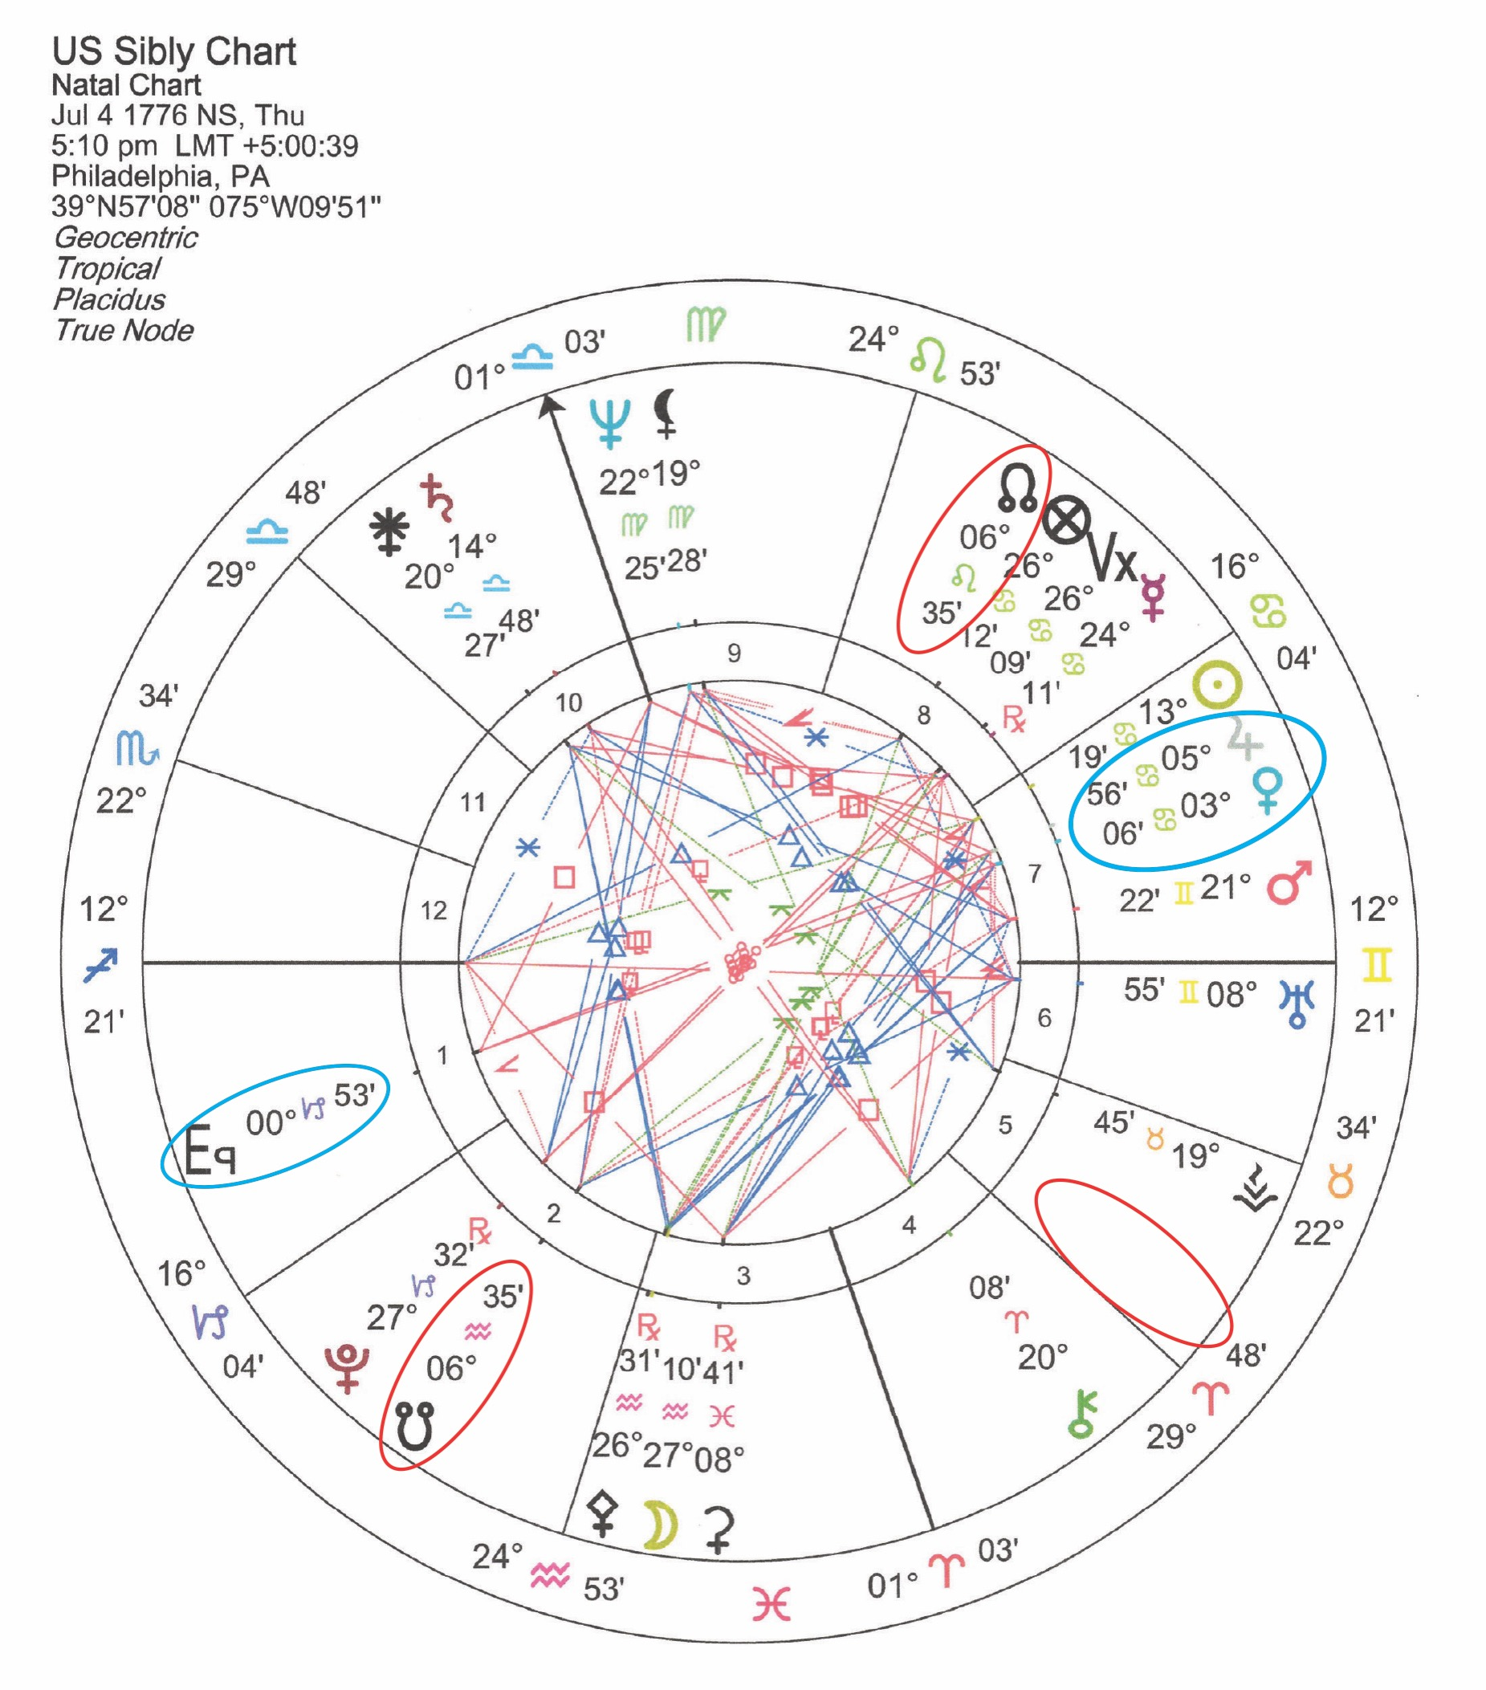
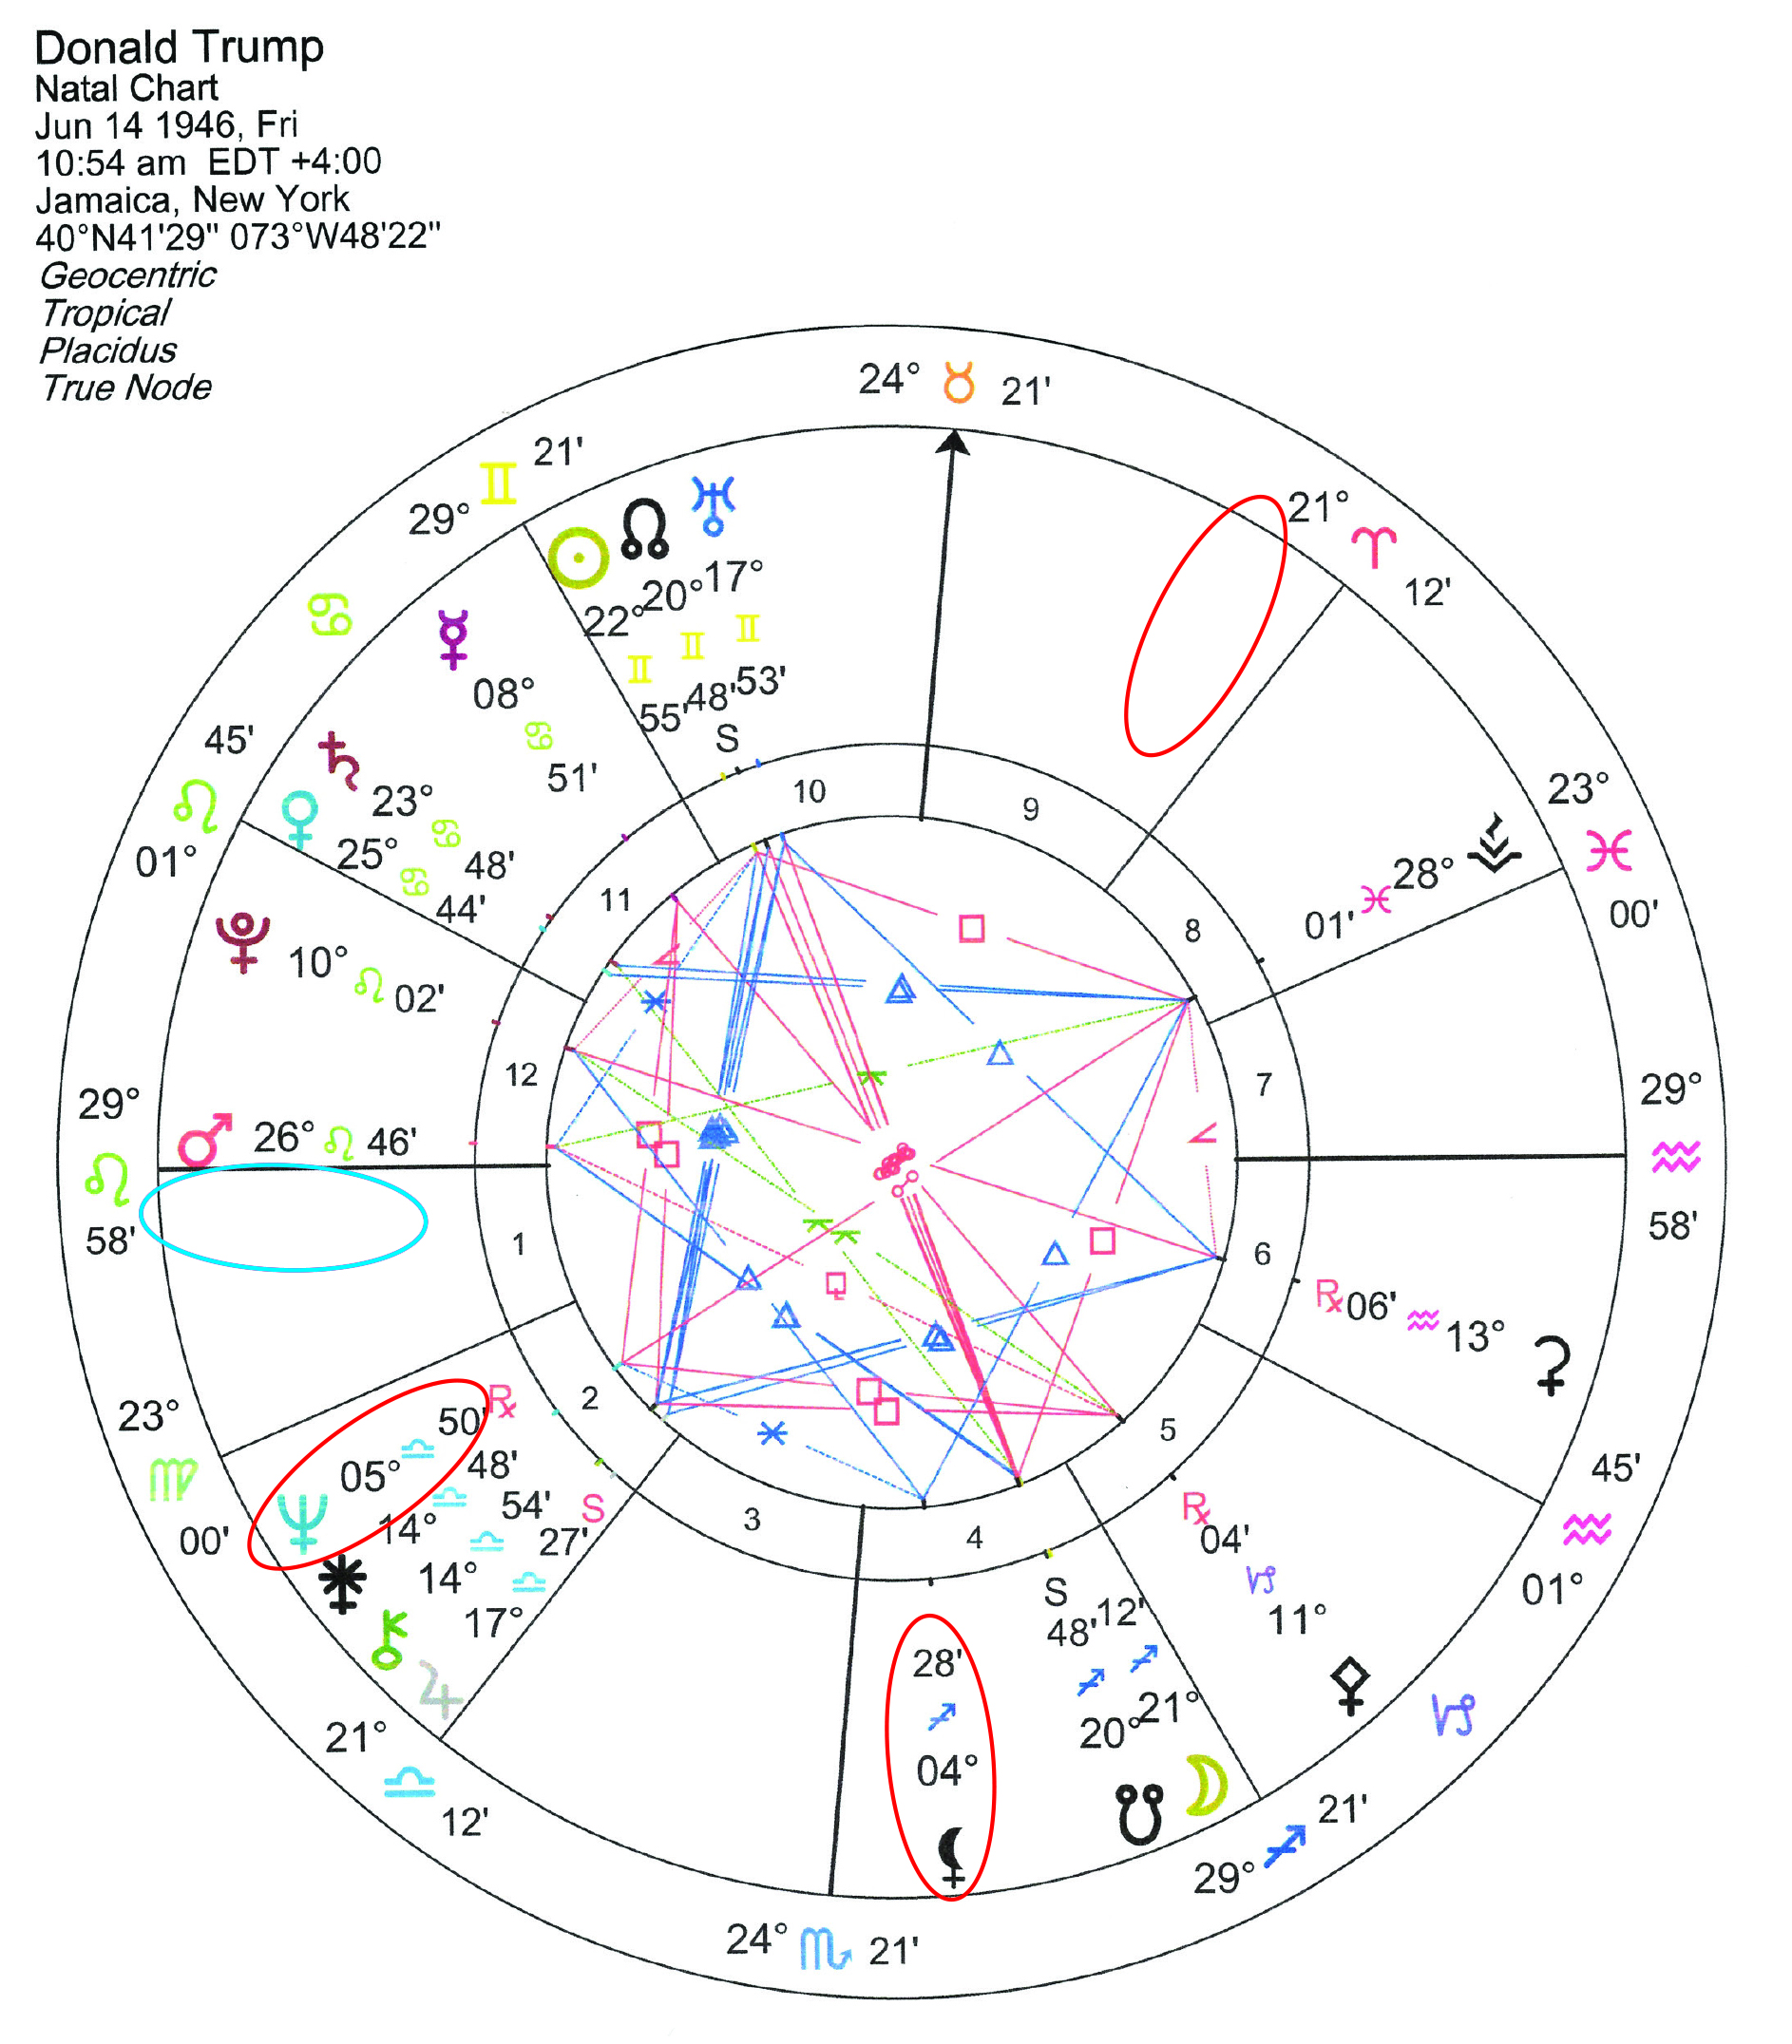
2019: UR 4-5° Tau: May 20- June 3rd (RxSep 21-Nov 12) YOD 2nd/4th/9th
2020: UR 4-5° Tau: March 9th – April 16th YOD 2nd/4th/9th
2019: UR 6° Tau: Jun 4-Aug 11, (Rx Aug 11-Sept 20) = UR T-square Nodes 2nd/5th/8th
2020: UR 6° Tau: Apr 17 – May 3rd = UR T-square Nodes 2nd/5th/8th

Slide 15
Liberations desiring security
in relationships with ‘substance’...
March 1 VE 29° Cap square UR 29° Ari
Provoking a Fight in Love Relationships
Good day to get things out into the open for understanding.
New or unexpected experiences may test flexibility in relationship.
Bored - Looking for excitement.
Impulsive spending.
March 6-26 UR 0° Tau squ LE 0° Leo (USA 10th/MC opp 4th/IC)
Unexpected changes in partnerships or contracts test your leadership.
Sudden changes in your economics and material involvements with marriage, business partnerships or one-to-one commitments.
You will need to be extremely flexible in matters with money and possessions.
Your values or your partners values may be changing. You may break away from people or contracts that are no longer working. Or you may bring in new partners in line with your new values.
Uranus in Taurus
March 6th, 2019 | New Moon 15° Pisces through July 8, 2025
New focus on innovation in producing wealth, by being resourceful, productive, stable.
Revolutionary changes in Economic and Material Situations. Can Bring in Sudden Windfalls or Sudden Losses.
Changes in values bring in opportunities for transition of power, structure & peace.
Possible sudden changes in means of earning a living, love, fertility, possessions, food, entertainment.
Prepare your finances, money, property to withstand flexibility and sudden changes.
Technological Advances Progressive Reforms
In Practical Earth/Food Sciences Conservation of Resources
March 6-8 Chiron 0° Aries semi-sextile UR 0° Tau
Emotional Healing and Integration.
Yielding to What is to Be.
To teach and heal through inspiring – to be grounded in the physical or financial world, by combining positive energy to your resources and talents.
Physical integration of your body, mind and soul by releasing attachments.
Healing your vitality, awareness and immediate environment via self love.
March 27 VE 0° Pisces sextile UR 0° Tau
Stimulating Friends.
Compassionate love, romantic pleasure, unexpected donations of food, money or possessions may elevate your ‘self worth’ or ‘financial net worth’.
Reorganization, letting go of valued memories or possessions to make way for new growth and fertility, bringing in ‘the good life’.

Slide 16
Mars in Taurus
February 14 - March 30, 2019
Personal drive, energy, sexuality or aggression toward pursuing your wants and desires
For ‘material security’ in love, wealth or possessions.
Mars is in detriment in Taurus, low potency to defend self-worth, ‘decreased ability to act on personal values’.
A Good Time For: Stabilizing Resources and Productivity
Conservative and patient action applied to earning and spending habits.
Seeking independence, comfort and enjoyment of the material world.
Strengthening finances, earning capacity and fortifying personal savings.
Focused energy on sensual love, romance, food, pleasure, ambiance.
Initiating dependable ‘resources’ or talents for practical survival needs
Impulsive entertainment, artistic activities, cosmetic or social affairs, cultured engagements, celebrations, restaurants, theaters, weddings.
Passion, loyalty and stability for what is loved and valued most.
Possible Difficulties:
Angry stubborn flare-ups/fits • Aggressively materialistic
Possessive in love • Passive in standing against the status quo.
Too security-oriented with money – afraid to take risks.

Slide 17
Key Themes
2019 - Mars / Jupiter
Drop Baggage – Let Go – Forge Ahead
Getting ready to Make the Shift in 2020.
Mars applying in its expression of ‘releasing out-dated limitations, structures or burdens’ all year– until it’s conjunction in March of 2020
Making a fresh new start with your identity and relationships.
Intense passions start off the year, craving union with others – ‘whatever it takes’ to fulfill your emotional or financial needs.
Take action - a new game plan, focusing on YOUR performance via: establishing a new environment, new energy of self motivation, played out for a ‘professional, public, or business adventure’.
You will be preparing to establish a new order in 2020. Revising and rearranging yourself, your body, location, life, relationships & how others see you.
Forging Ahead with Growth of Expertise
Becoming an ‘authority of your ‘word’, through hard work.
Partnering with and/or valuing foreign interests, beliefs, expertise or wisdom is on the horizon (mid Jan, 2019)
A focus on ideals and growth planning. ‘optimizing upon’ the laws of attraction and manifestation – of what you ‘know’.
Hard work and demonstration, may be met with much resistance, to your ‘dream’ to put your ‘spiritual’, ‘legal’ or ‘political’ view into practice in the real world.
Speaking your truth, combining facts with concepts, teaching others the big picture, promoting expertise through realism.
A quest to ‘know and understand’ faith in truth and justice, or spiritual beliefs, to increase knowledge, travel afar or ‘preach’.
January 1 - February 13: Plans moving forward for growth and expansion are flourishing FULL STEAM AHEAD.
Feb 14 – March 30: A dilemma that may need advice to resolve. Make adjustments, sort priorities, adjust for new growth in life.
March 31 - May 15: Quick reflex action. Repolarization of communications within immediate environment. Realization or opposition of what IS or IS NOT working.
May 16 – July 1: Rearranging personal values + resources to establish new order.
July 2 – August 17: Integration of growth into your life – blending, demonstrating, and communicating effectively. Self-focused.
August 18 – Oct 3: Hard work, stress of duty. Tests of spiritual growth + maturity of beliefs.
Oct 4 – Nov 18: Support from ‘new’ partners, Application of contracts, commitments. Reorganization, clearance of former partners.
Nov 19 – Dec 2: Emotional integration. Yielding.
Dec 3 - 31: Reputation, Career forges ahead...
Notes:
MA 18° Aqu Semi-Sex Pluto 18° Cap op SE: 18° Leo – USA 1st H

Slide 18
Pluto in Capricorn
January 2008 – January 2024 (16 years)
Pluto gives you either the power to achieve your life goals or it may alter your life direction to find the insight of what your goals truly are.
This will bring out your power that has been unseen,
invisible, and has been kept hidden.
You may undergo intense transformative experiences in your life; through your work and accomplishments.
Radical transformations of ‘power’ will be experienced.
People or events will change and transform your life.
You may try to take ruthless control of everything as loss is experienced.
Both destructive and creative forces may erupt in this process.
Ultimately, you may feel like you have become a different person.
A slow, responsible transformation of your authority is in the process of taking place – letting go of the attachment to your identity ‘that you thought you were’.

Slide 19
Bringing What is Buried Up to the Light of Day
Reality Shift Into a New Paradigm - and Letting Go of ‘old control patterns’.
March 30th – April 5th and beyond
South Node in Capricorn will transit to conjunct Pluto this month.
North Node in Cancer will transit to oppose Pluto this month.

Slide 20
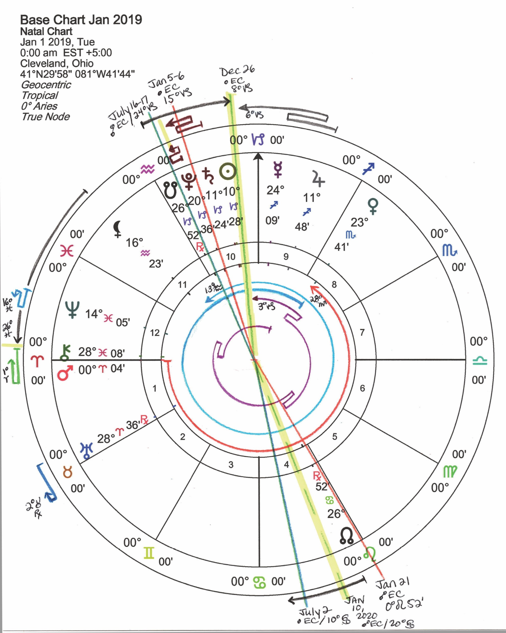
Realignment of Power Nodes in Cancer/Capricorn retrograding in expression ‘Letting go to lay a NEW foundation’– opposition/conjunction with Pluto Mar 30-Apr 5. 2019 –
Reality Shift Into a New Paradigm
Pluto reaches 23° Capricorn – Polarity Shift – Path Realignment
Collectively we will be ‘purging’ what no longer works (or is broken), with our structures of ‘Authority and Control’ in the outer world, leaving a ‘socially conditioned’ past behind.
Letting go of the authority + power of ‘Who We Thought We Were’.
A rediscovery of our ‘Natural Instincts” unlocking the door for our ‘Buried Inner Power’ or True Selves’ to be reborn.
Complete understanding that you need to let go of individual freedoms to focus on building stability of income, assets, love, or value of the enterprise you created. (SN 23° Cap conj PL 23° Cap)
Intense restructuring of both your home/family and business commitments. Duties of the past are calling - your reputation is on the line - your focus is on the stability of the core operation – ‘which IS your future’. (SA 20° Cap oppose SE/LE 20° Can 2018-20)
Changes in public image and authority – letting go of the ‘false mask’ and letting your true ‘soul power’ out the box for all to see. Standing in your power and owning it.

Slide 21
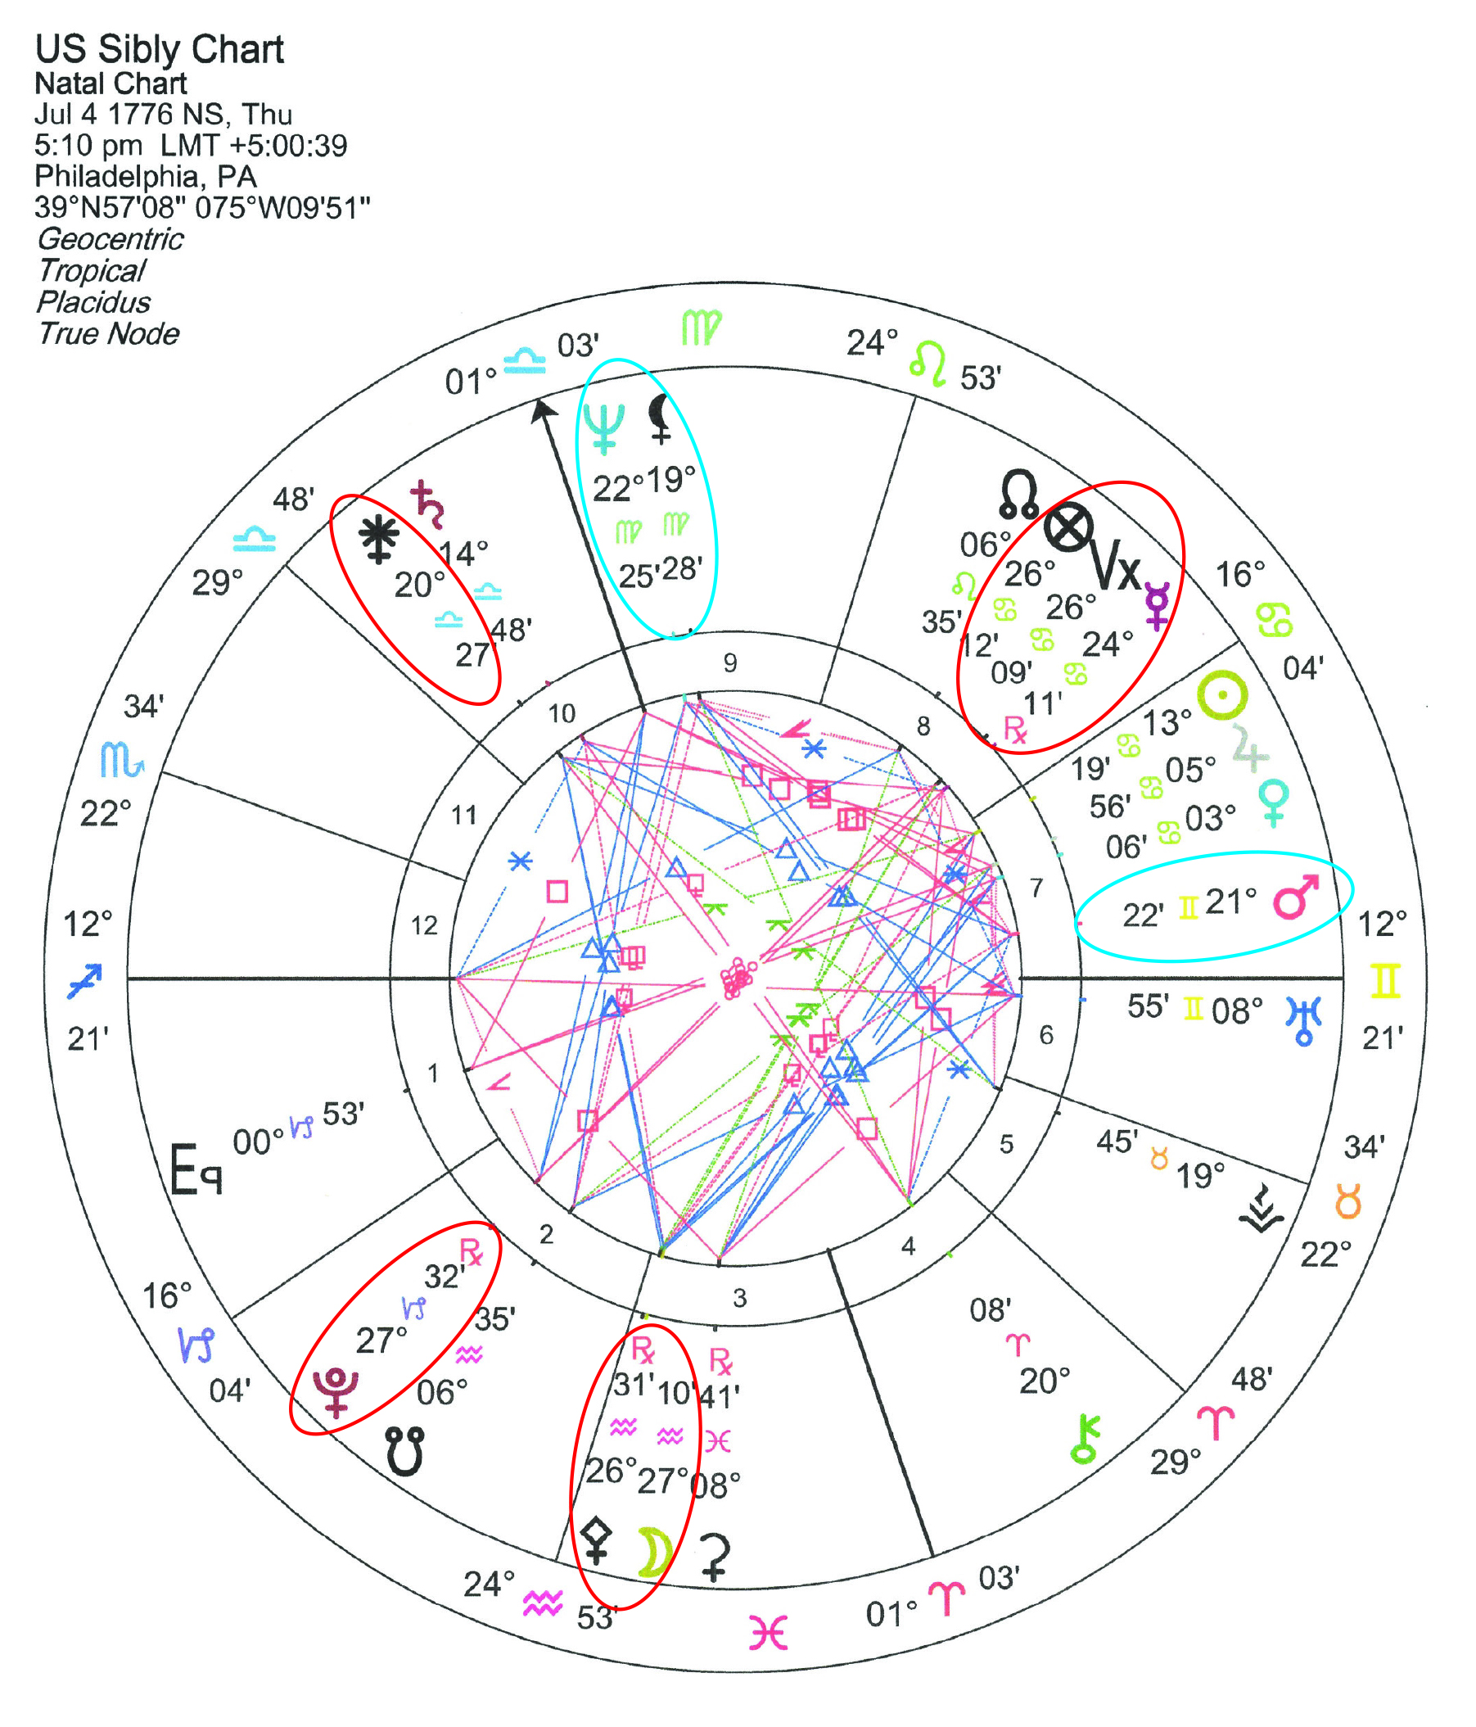
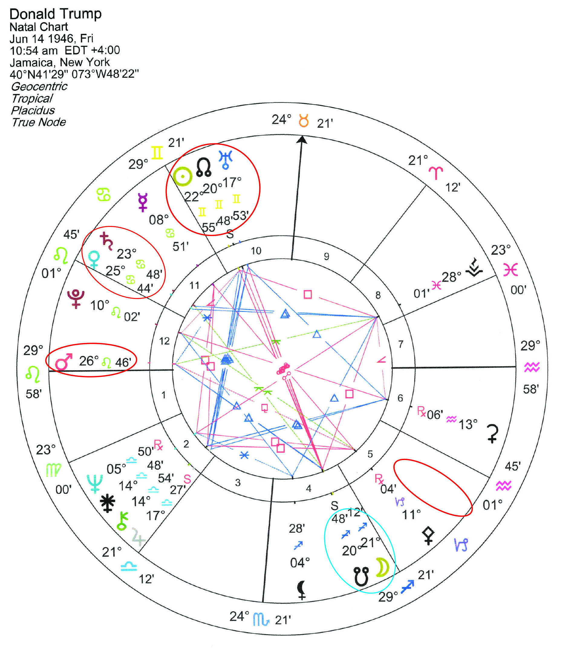
2019: PL 23° Cap conj SN 23° Cap; oppose NN 23° Can: March 30 – April 5th
YOD = PL (5th) opp SA(11th); quincunx Mars (12th) and UR/NN/SU (10th)
2019: PL 23° Cap conj SN 23° Cap; oppose NN 23° Can: March 30 – April 5th
T-Square = PL (2nd) opp ME(8th) sq Juno (10th); PL/SN qcx Mars (7th), NN qcx MO (3rd)

Slide 22
Realignment of Power...
Reality Shift Into a New Paradigm
Pluto reaches 23° Capricorn – Polarity Shift – Realignment of Power
Collectively we will be ‘purging’ what no longer works (or is broken), with our structures of ‘Authority and Control’ in the outer world, leaving a ‘socially conditioned’ past behind.
Letting go of the authority + power of ‘Who We Thought We Were’.
Complete understanding that you need to let go of individual freedoms to focus on building stability of income, assets, love, or value of the enterprise you created. (SN 23° Cap conj PL 23° Cap)
Intense restructuring of both your home/family and business commitments. Duties of the past are calling - your reputation is on the line - your focus is on the stability of the core operation – ‘which IS your future’. (SA 20° Cap oppose SE/LE 20° Can 2018-20)
Changes in public image, authority – letting go of the ‘false mask’ and letting your true ‘soul power’ out the box for all to see. Standing in your power.
March 12-24 NN 24° Can quincunx Lilith 24° Aqu
Revise, Rearrange and Getting Ready to Establish a New Order
Unexpected inconvenience of expectations from friends or group.
Angry, looking at ‘foundation of self, home or family’ - seeing the need to change your ‘feelings for security’.
Has excessive ambition and need for social accomplishment gotten you into this quandry?
March 25-26 JU 23° Sag quincunx NN 23° Can
A dilemma of sorting priorities and making adjustments.
Growth and abundance of expertise, promotional freedoms and pursuing expansion of your awareness have brought in new opportunities for professional responsibility and recognition.
Your home, family, or emotional foundation may be strained and cannot support growth.
You may need to pick and choose what to keep and what to let go of.
March 22-23 MA 24° Tau sex NN 24° Can | sq Lilith 25° Aqu
Applying Yourself, Your Money, Valued Resources to Protect Future Security.
Sudden reforms and action required to assist the security of home, family or public enterprise.
Overcoming angry resistance from group or lack of funds available from company, so you may contribute your own assets to help support situation.
March 30 – April 5 PL 23° Capricorn oppose NN 23° Cancer
Polarity Shift. Realignment of Power.
Complete empowerment to address and align with your ‘true self’, your inner passions and soul purpose for being on this planet.
Realization that past authority, reputation serving the ‘status quo’ conservative operations are no longer fulfilling or efficient.
Forced or fated changes, to get you back on your ’soul’ path, or powerful reinforcement for it if you are already on it.

Slide 23
Pluto in Capricorn
January 2008 – January 2024 (16 years)
As Humanity, we are at the point of synthesis with this Pluto cycle:
permanently changing our unconscious psyches - at the core level.
Demonstrating, sharing and communicating what we have learned.
This year, starting in February - Pluto will reach the last quarter mark of it’s journey through Capricorn.
Reorientation – Bringing in a ‘Crisis in Consciousness’
This will test or break us - holding us accountable (endings and/or beginnings) – for our karma due
Turning away from old responsibilities/accomplishments and following new inspirations.
We will all have the choice to ‘to be reborn into a new conscious reality’ – one of life, birth, healing, energy, light, and love.
20°, 21°, 22°, 23°, Capricorn in 2019
These four degrees are being ‘cooked’ in all of our charts, all year.
By 2024 we will understand -- and honor what is ultimately at stake…
Stewardship and Protection of our Earth, Our Heritage, Home, Family, Real Estate, Land, or Our Core Foundation.

Slide 24
Path of Spiritual Focus November 6, 2018 – May 5, 2020 (19 mo.)
Moons Nodes (+ Eclipses) in Cancer/Capricorn
As a humanity are working on balancing our overemphasis of excessive ambition and being too focused on social accomplishments
by learning how to develop ‘feelings’ and
learning to unconditionally accept ourselves and our feelings for security. To allow ourselves to be vulnerable and not to loose our sovereignty for humanity by getting lost in excessive ambition.
Ultimately focusing on the protection of our families, our heritage, homeland, and planetary foundation - realizing that ‘all is one’.

Slide 25
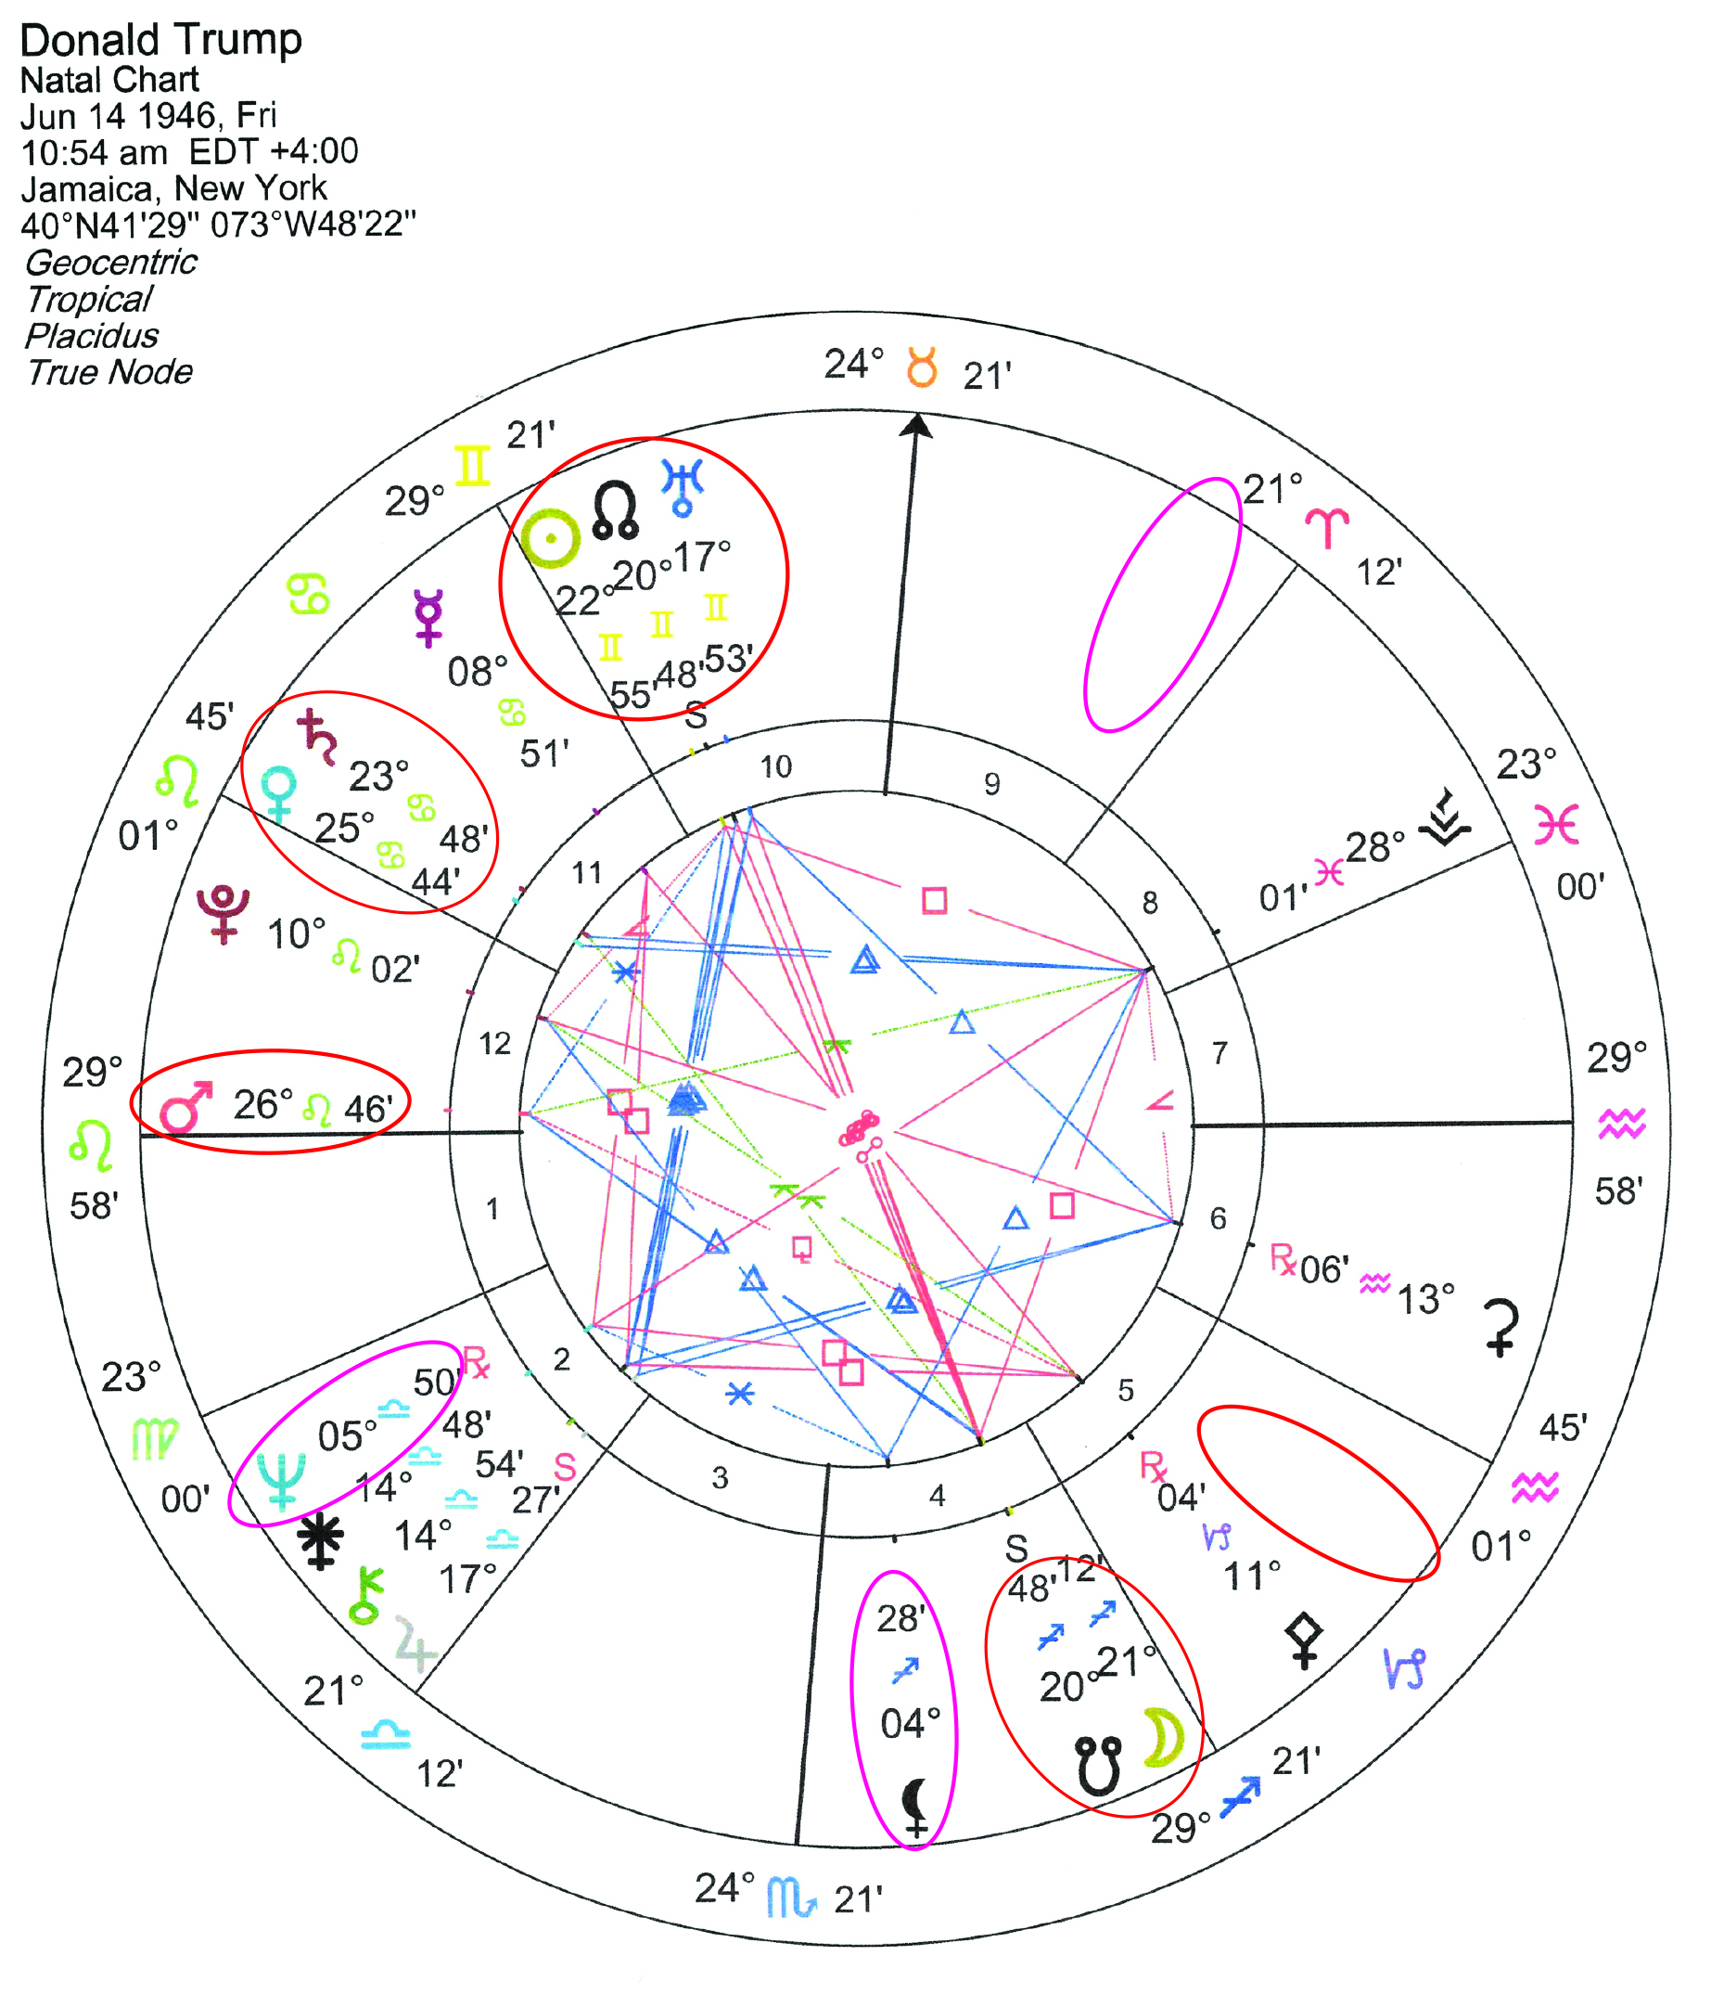
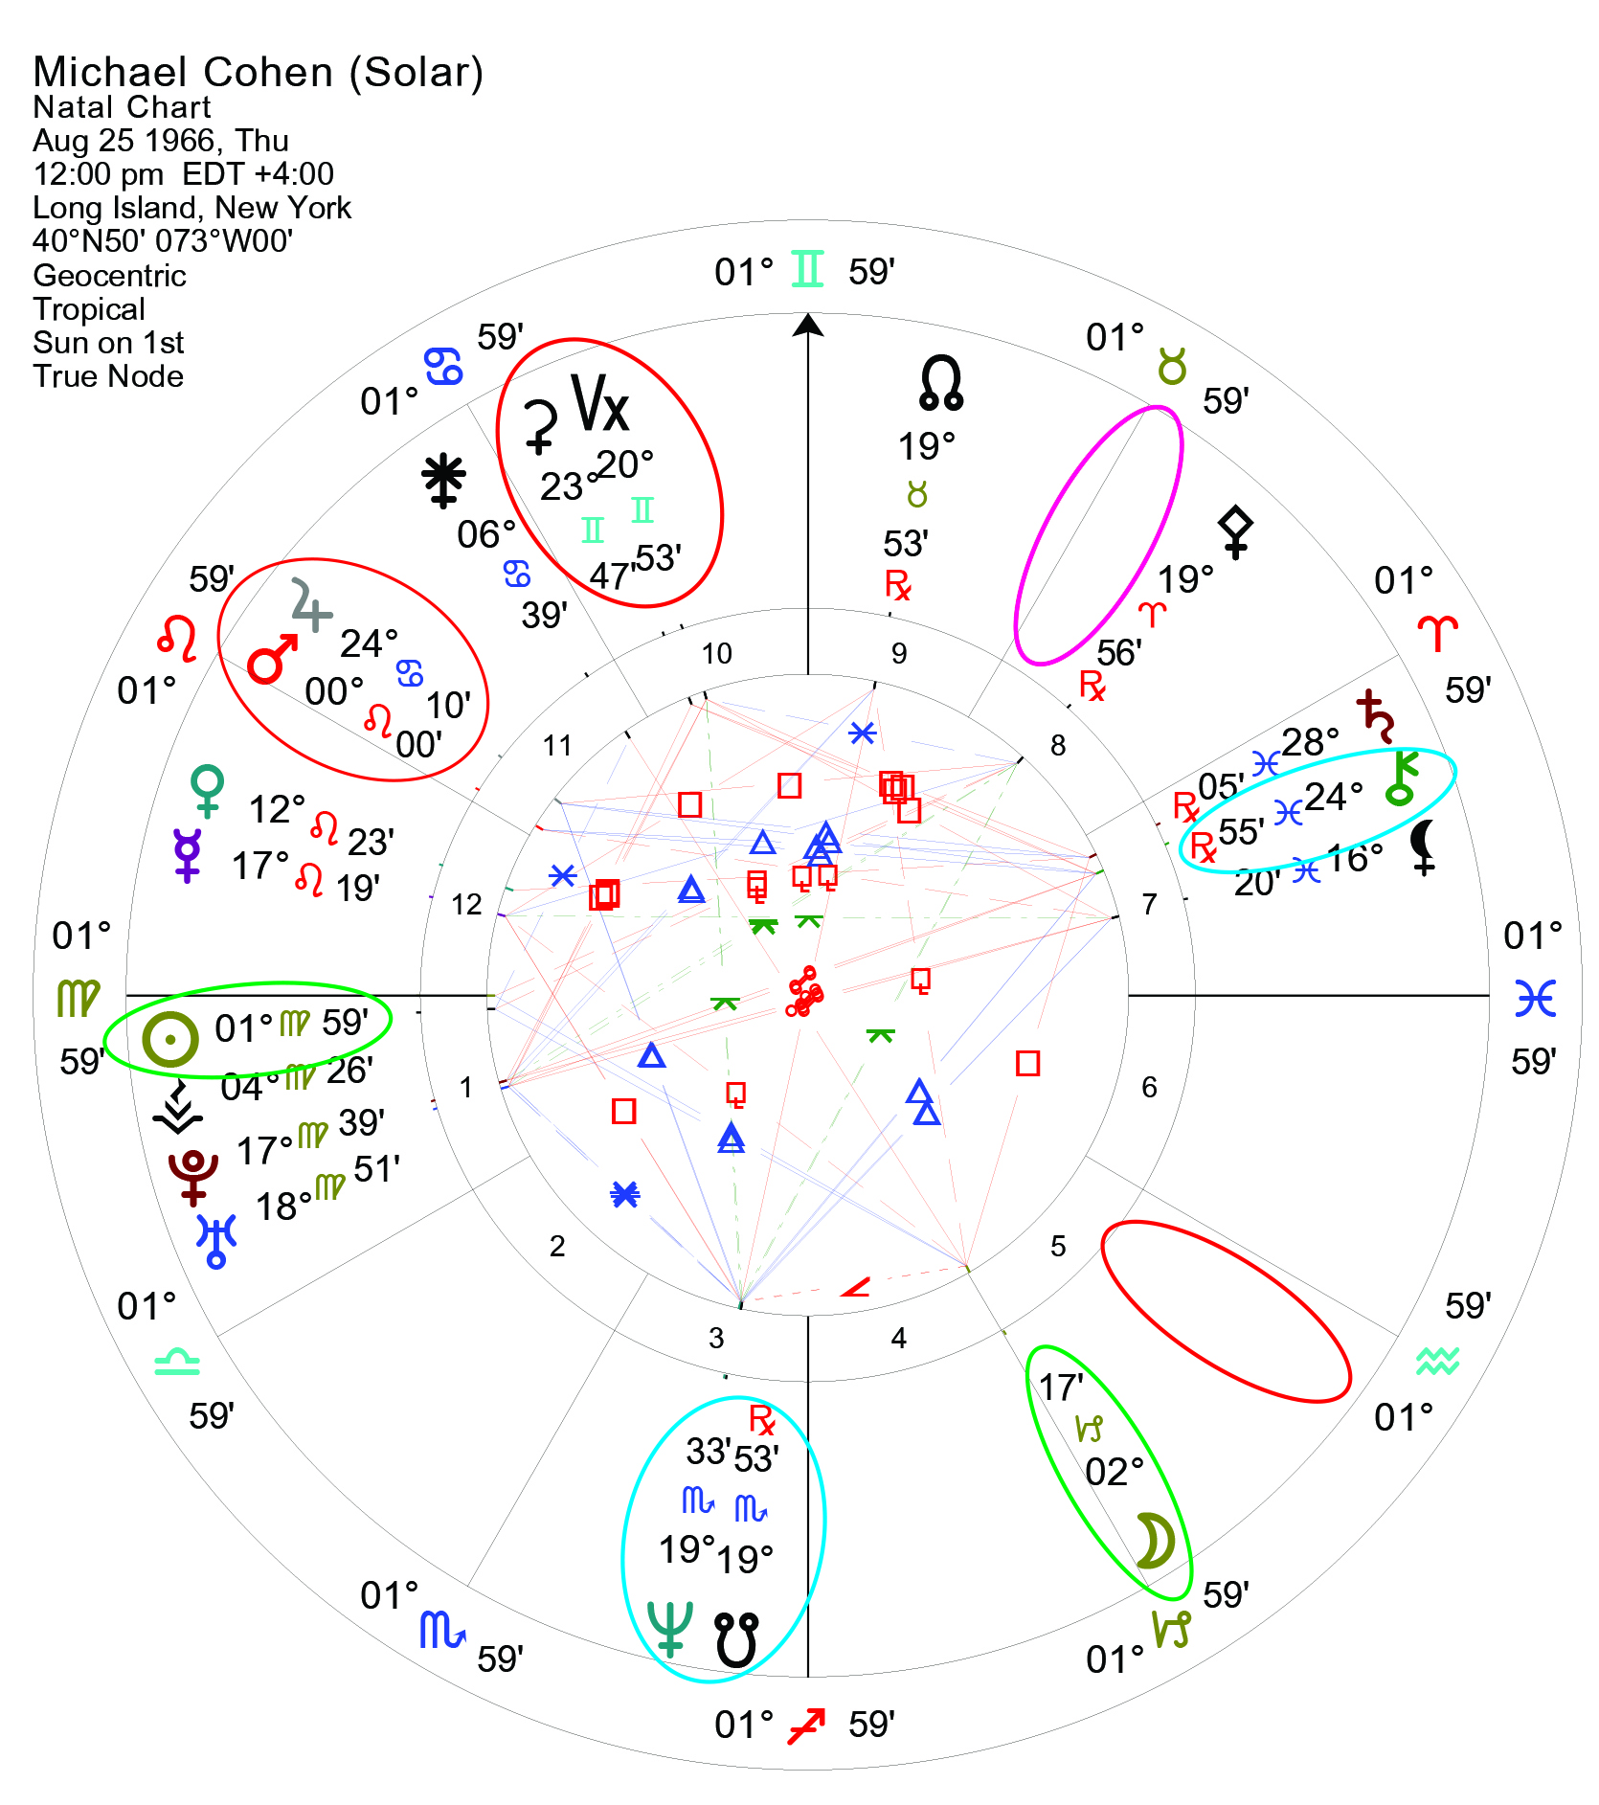

Slide 26
Thank You!

